Slide 1


Search for staus and electroweakinos production in compressed region using the final states with two hadronic taus or one hadronic tau one lepton
Chengxin Liao On behalf of the EWK-2tau team
liaocx@ihep.ac.cn
May, Fri 16, 2025

Slide 2
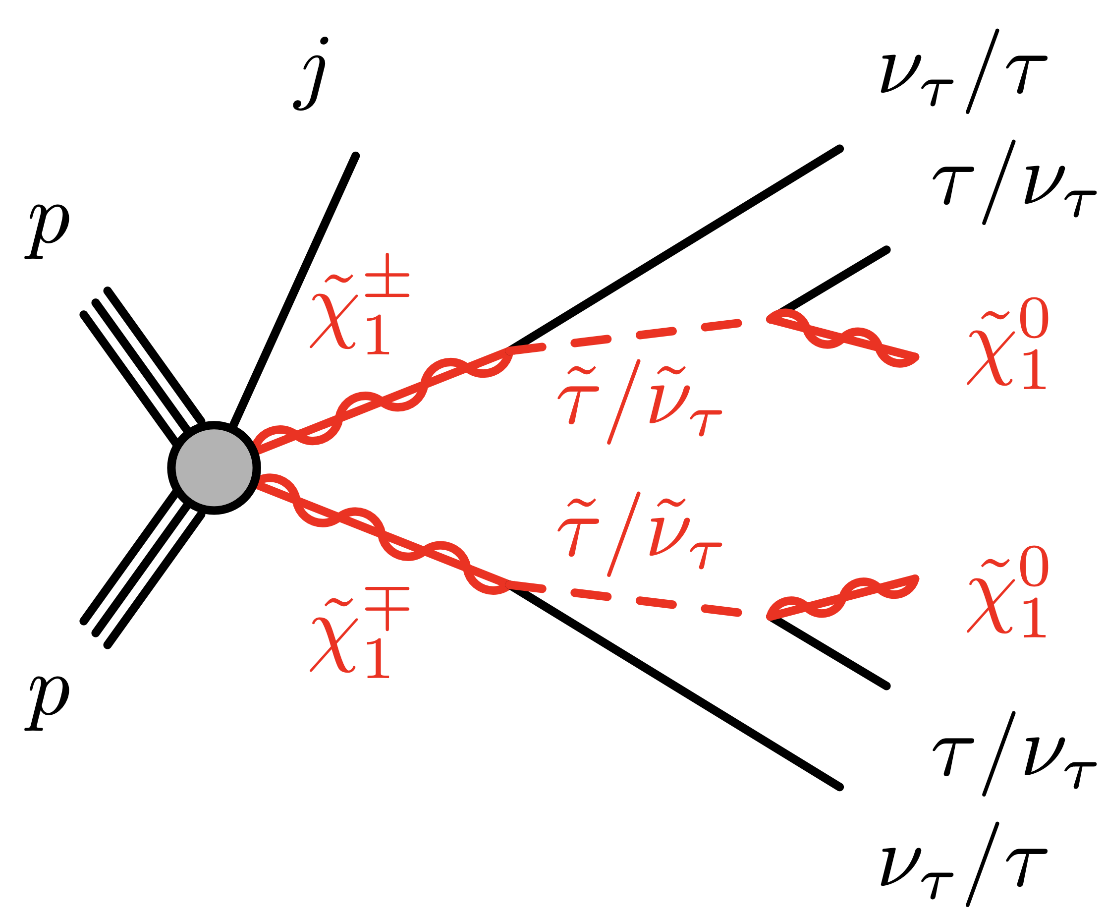
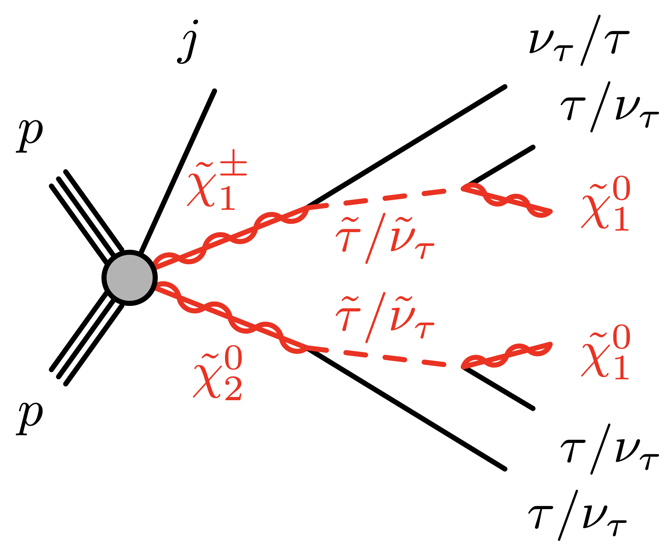
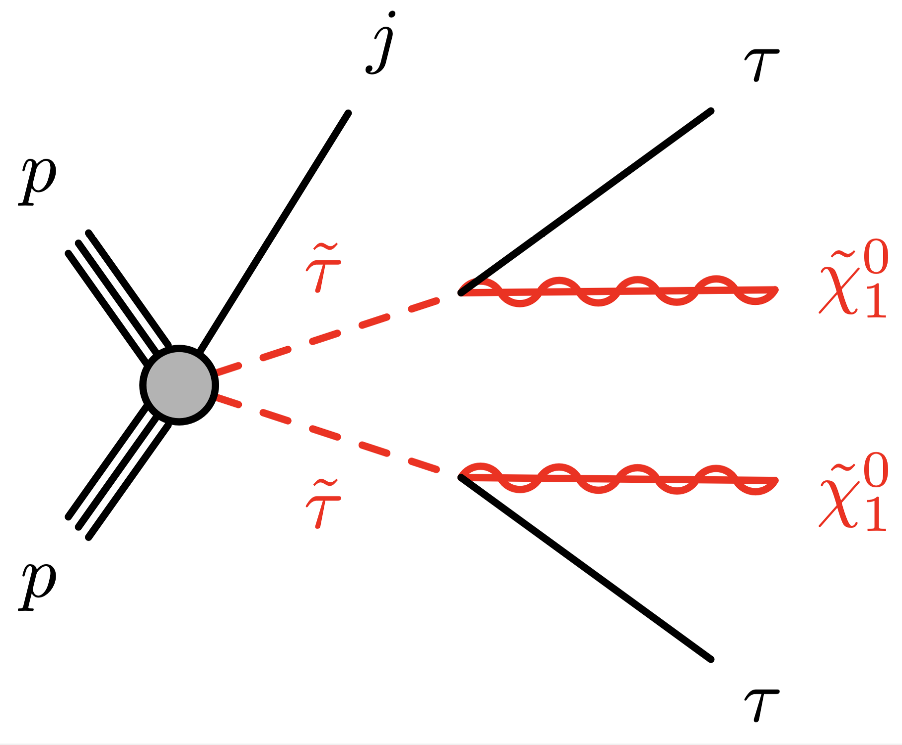
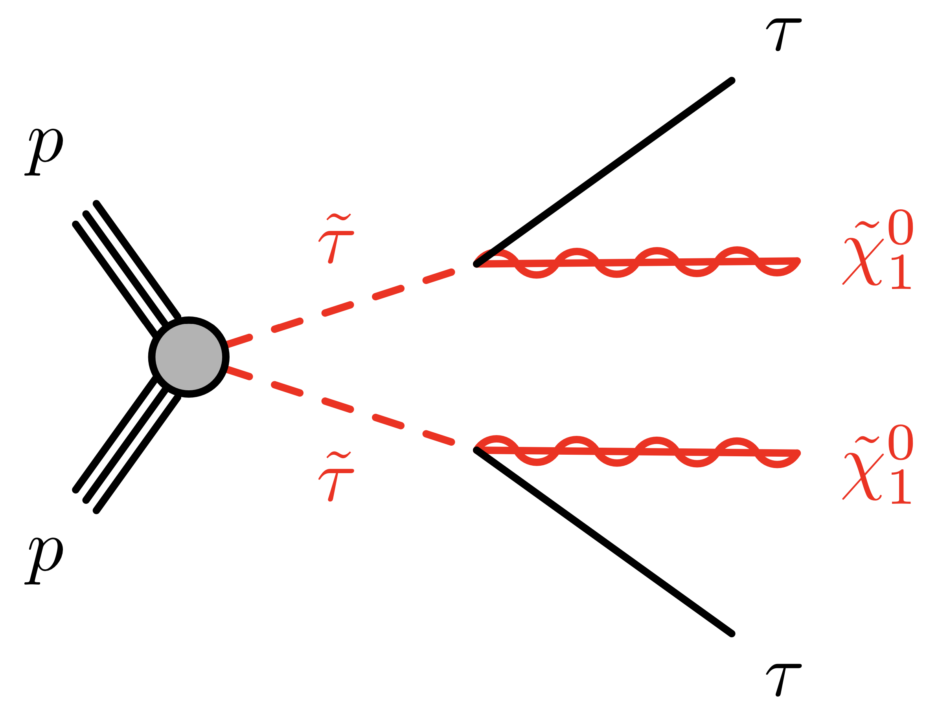
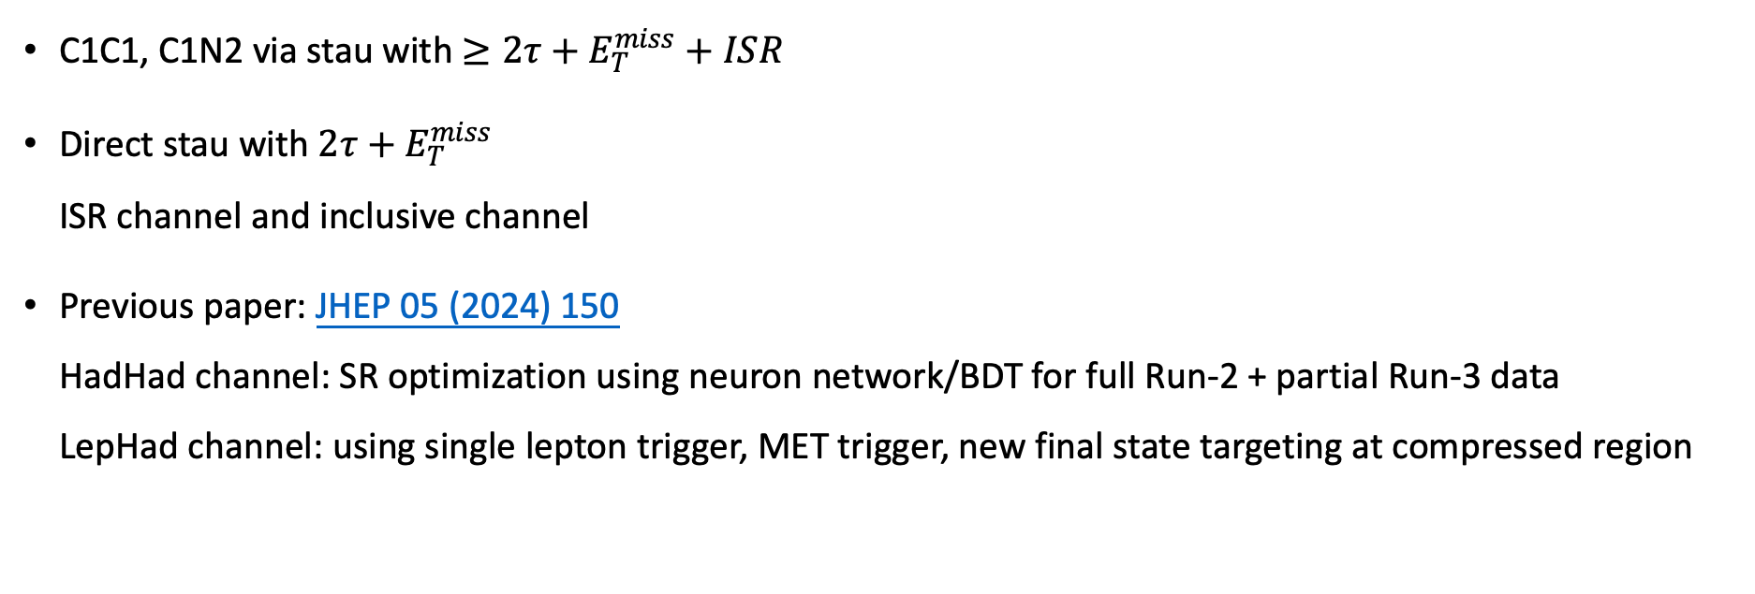
Target Signal
C1C1, C1N2 via stau with $≥2τ+E_{T}^{miss}+ISR$
Direct stau with $2τ+E_{T}^{miss}$ ISR channel and inclusive channel
Previous paper: JHEP 05 (2024) 150 HadHad channel: SR optimization using neuron network/BDT for full Run-2 + partial Run-3 data LepHad channel: using single lepton trigger, MET trigger, new final state targeting at compressed region
1 or 2 jets, leading jet at least 50 GeV
0,1,2, jet
1
Chengxin Liao
C1C1/C1N2 and Direct stau PAR

Slide 3
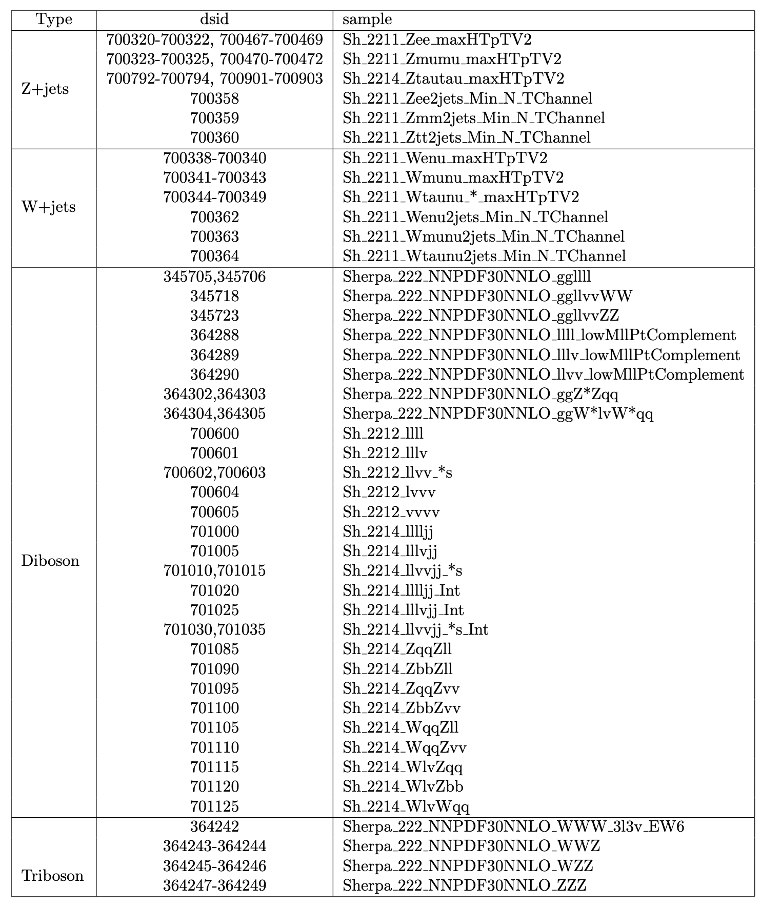
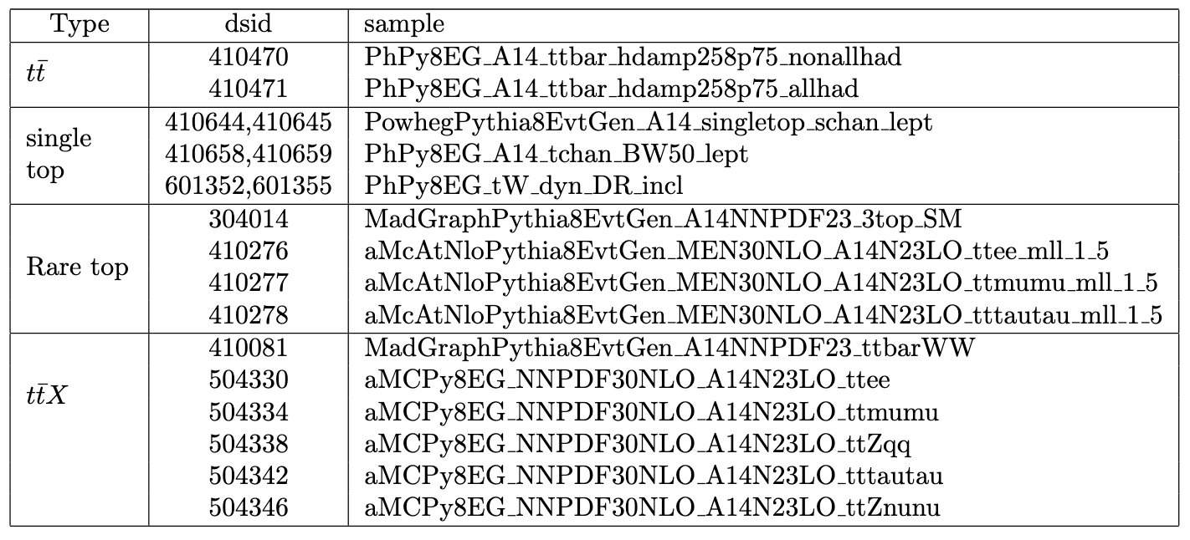
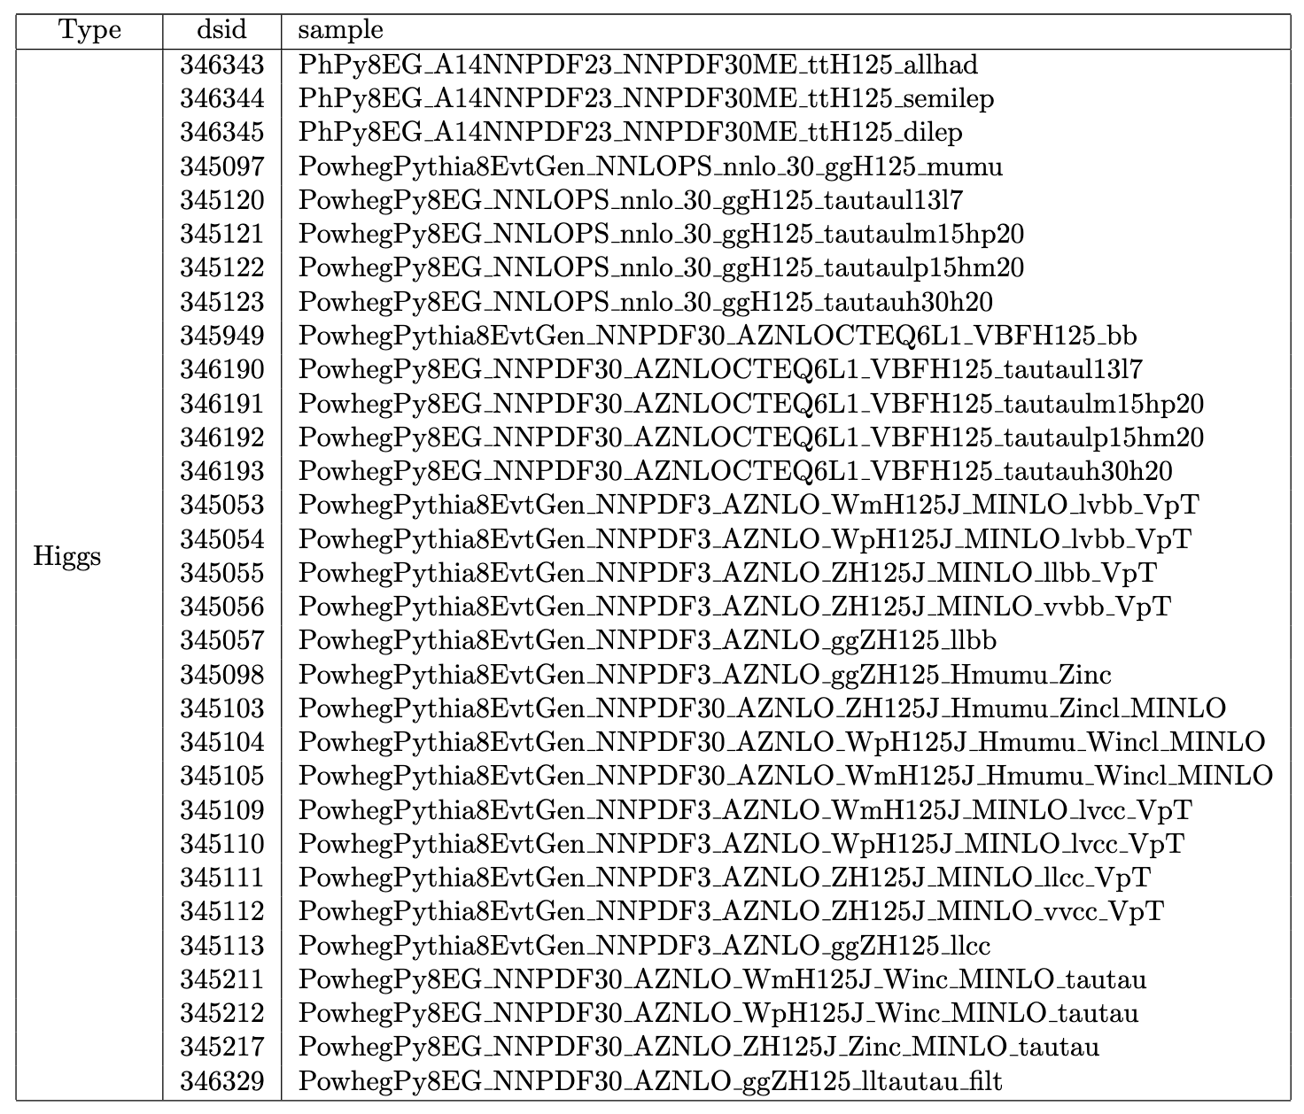
Ntuple setup
MelAnalysis framework
DAOD PHYS
ptag: signal p6244, bkg p6490/p6491, data p6479/p6269
background list: mc20, mc23
run2
run3
2
Chengxin Liao
C1C1/C1N2 and Direct stau PAR

Slide 4
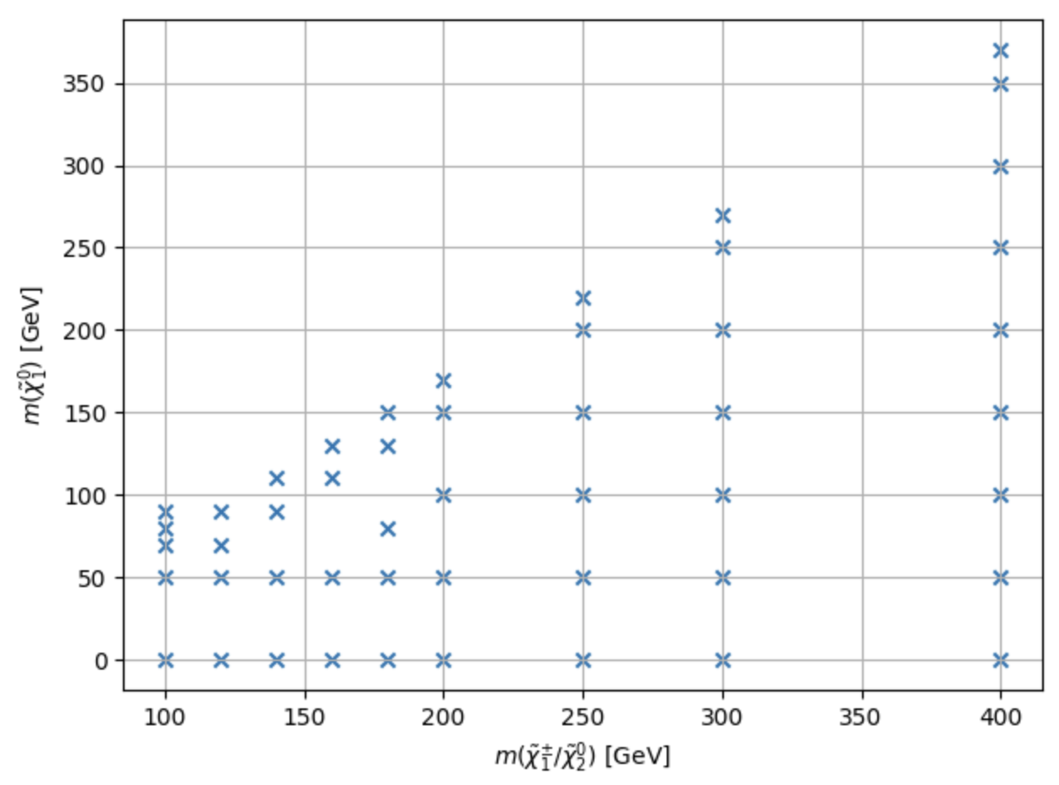
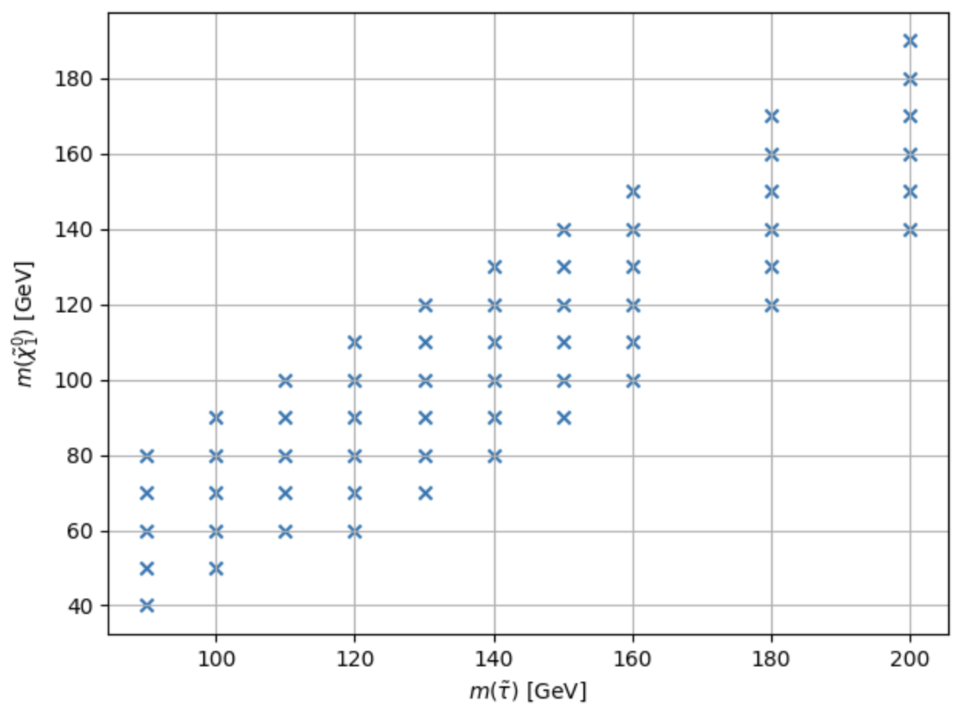
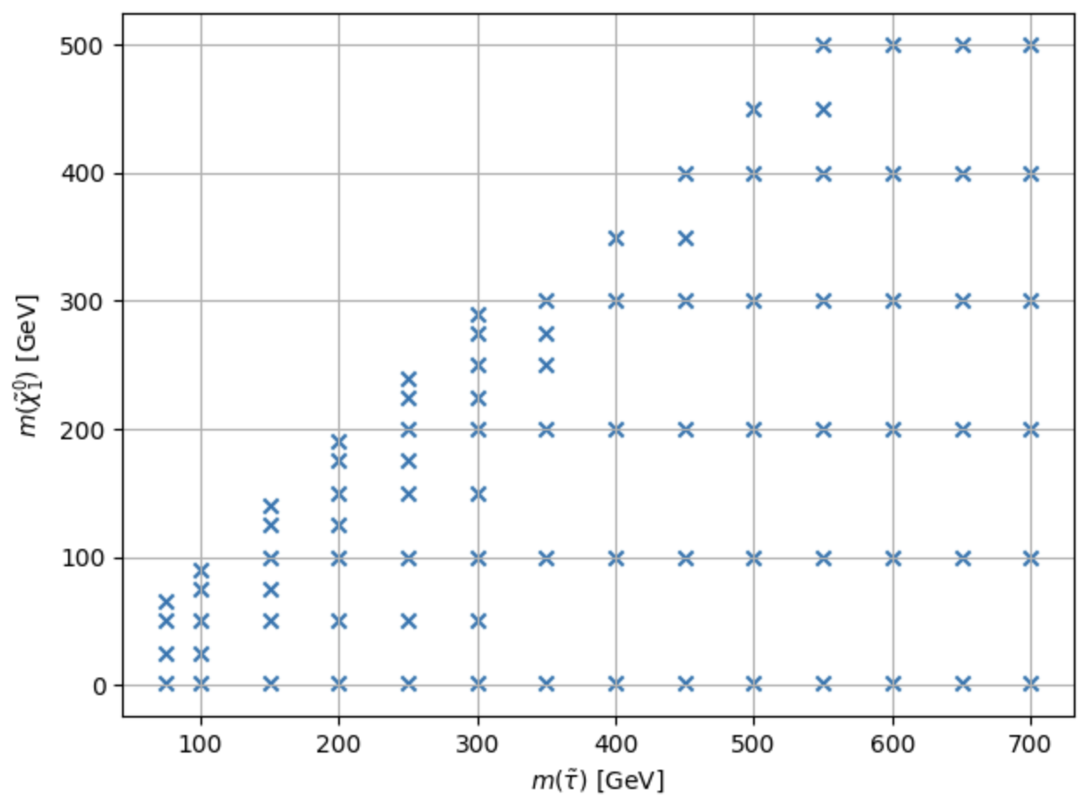
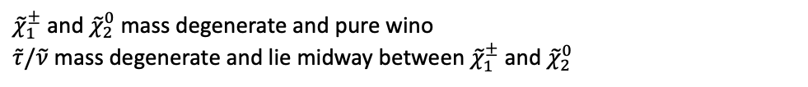
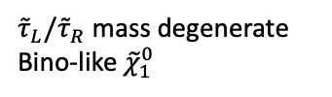
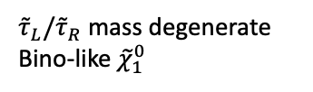
Signal samples
${\tilde{τ}}_{L}/{\tilde{τ}}_{R}$ mass degenerate
Bino-like ${\tilde{χ}}_{1}^{0}$
${\tilde{χ}}_{1}^{±}$ and ${\tilde{χ}}_{2}^{0}$ mass degenerate and pure wino
$\tilde{τ}/\tilde{ν}$ mass degenerate and lie midway between ${\tilde{χ}}_{1}^{±}$ and ${\tilde{χ}}_{2}^{0}$
${\tilde{τ}}_{L}/{\tilde{τ}}_{R}$ mass degenerate
Bino-like ${\tilde{χ}}_{1}^{0}$
3
Chengxin Liao
C1C1/C1N2 and Direct stau PAR

Slide 5
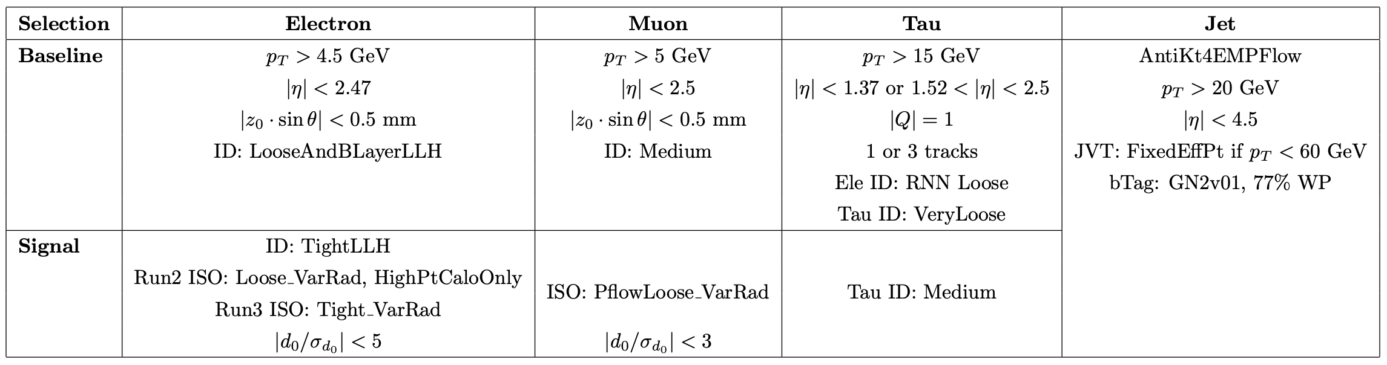
Object Definition
Full ST config: Run2, Run3
impact parameter
4
Chengxin Liao
C1C1/C1N2 and Direct stau PAR

Slide 6
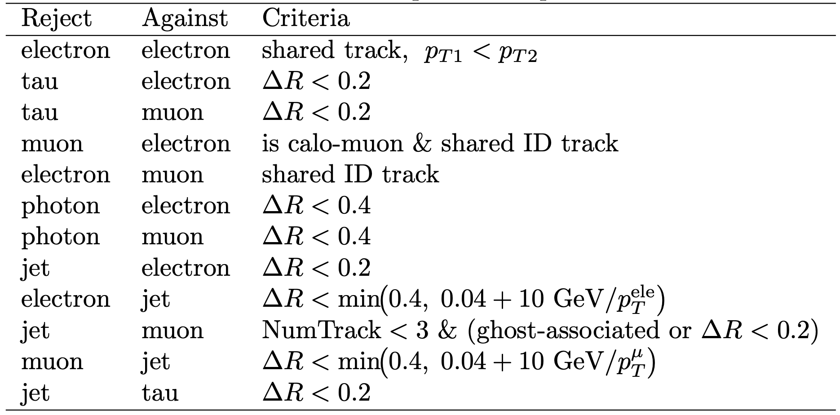
Overlap Removal
ST default overlap removal
Do Tau OLR
5
Chengxin Liao
C1C1/C1N2 and Direct stau PAR

Slide 7
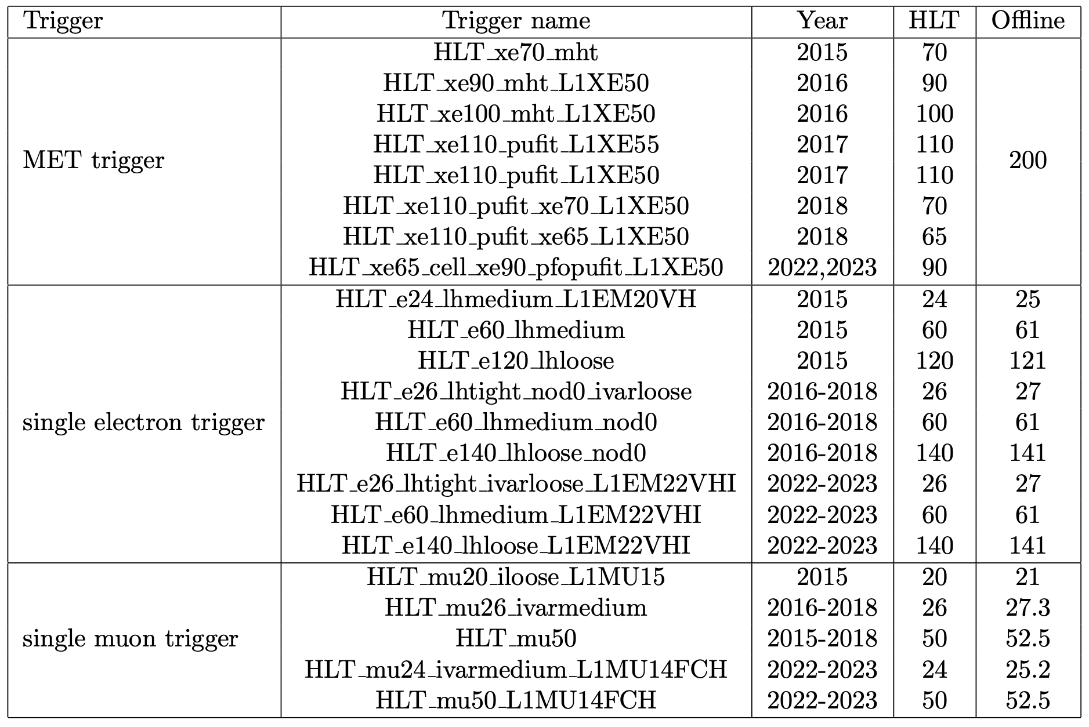
Trigger Strategy
Stau:
MET trigger for high MET region,
Single lepton trigger for low MET region
C1C1/C1N2: MET trigger
6
Chengxin Liao
C1C1/C1N2 and Direct stau PAR

Slide 8
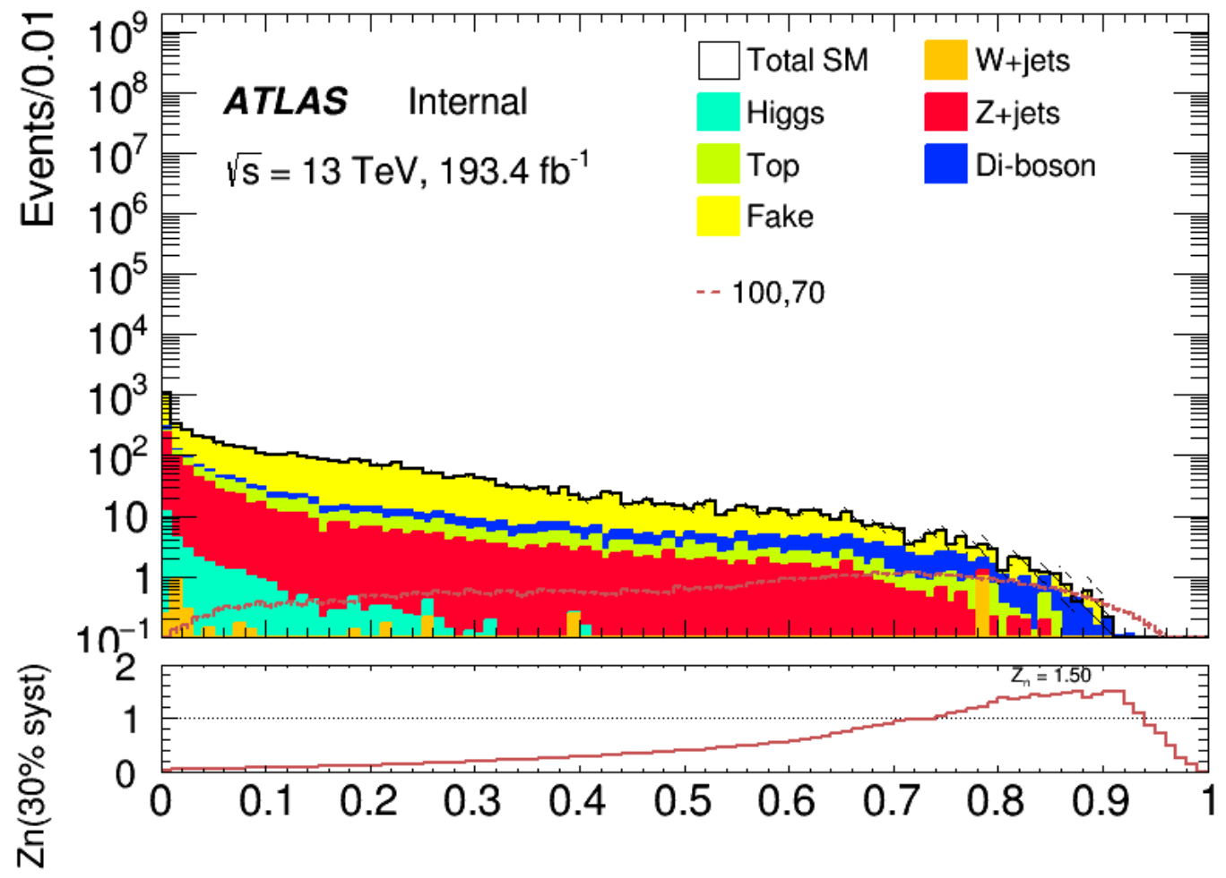
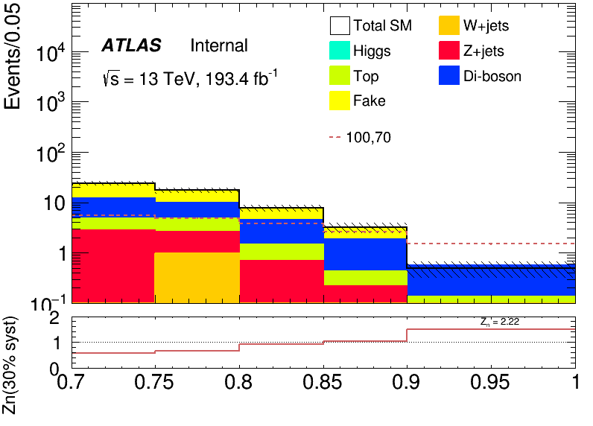
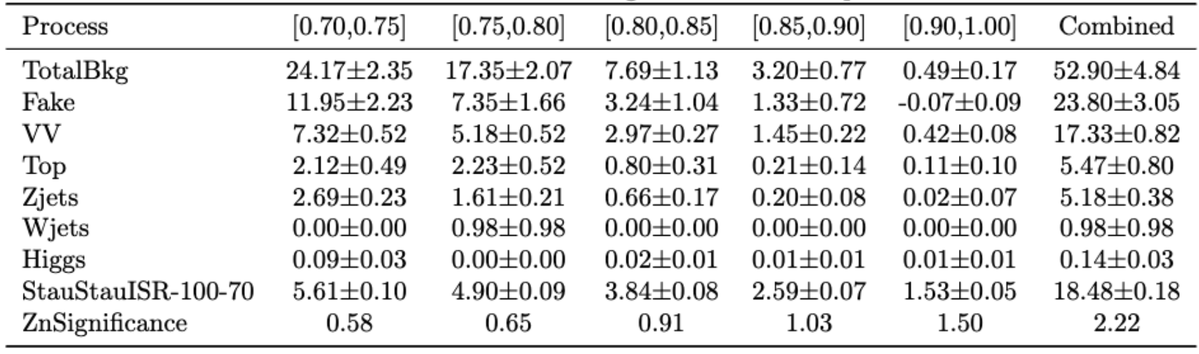
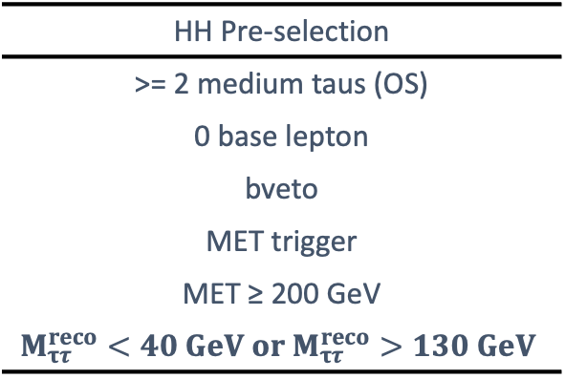
Direct Stau ISR signal region definition(HH)
Preselection
SR selection using neuron network score
Fake tau estimation using fake factor method
DNN signal score > 0.7
Background composition
HH Pre-selection
>= 2 medium taus (OS)
0 base lepton
bveto
MET trigger
MET ≥ 200 GeV
$$M_{ττ}^{reco}<40 GeV or M_{ττ}^{reco}>130 GeV$$
SR
Pre-selection
DNN score > 0.7
7
Chengxin Liao
C1C1/C1N2 and Direct stau PAR

Slide 9
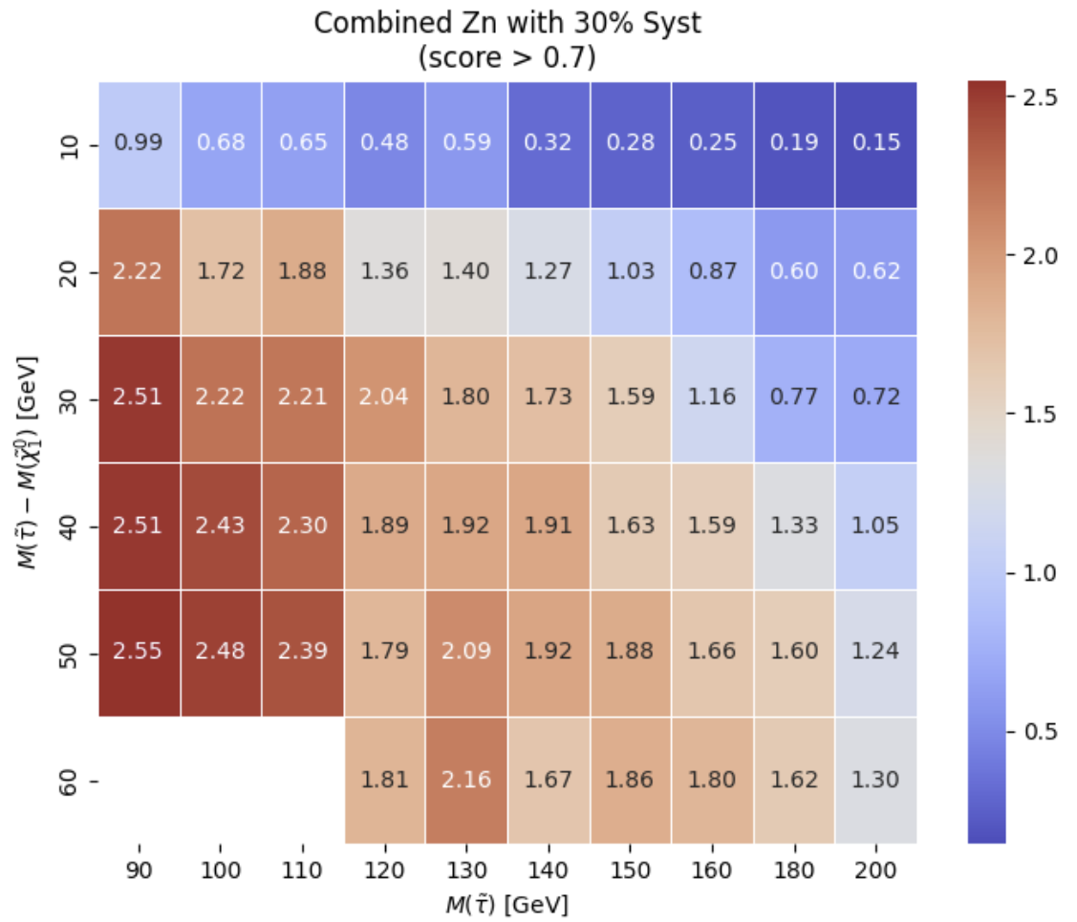
Direct Stau ISR signal region definition(HH)
Expected sensitvity
30% flat systematic uncertainty
8
Chengxin Liao
C1C1/C1N2 and Direct stau PAR

Slide 10
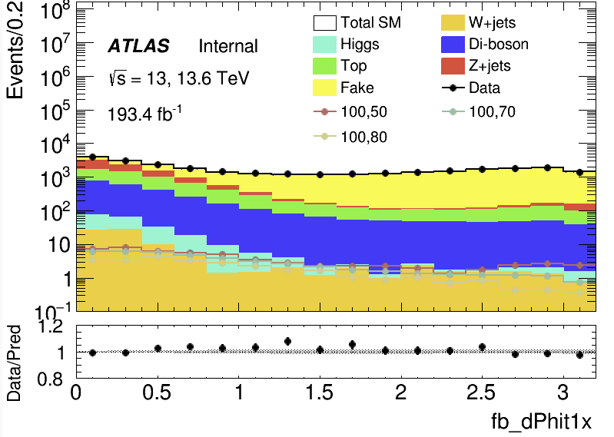
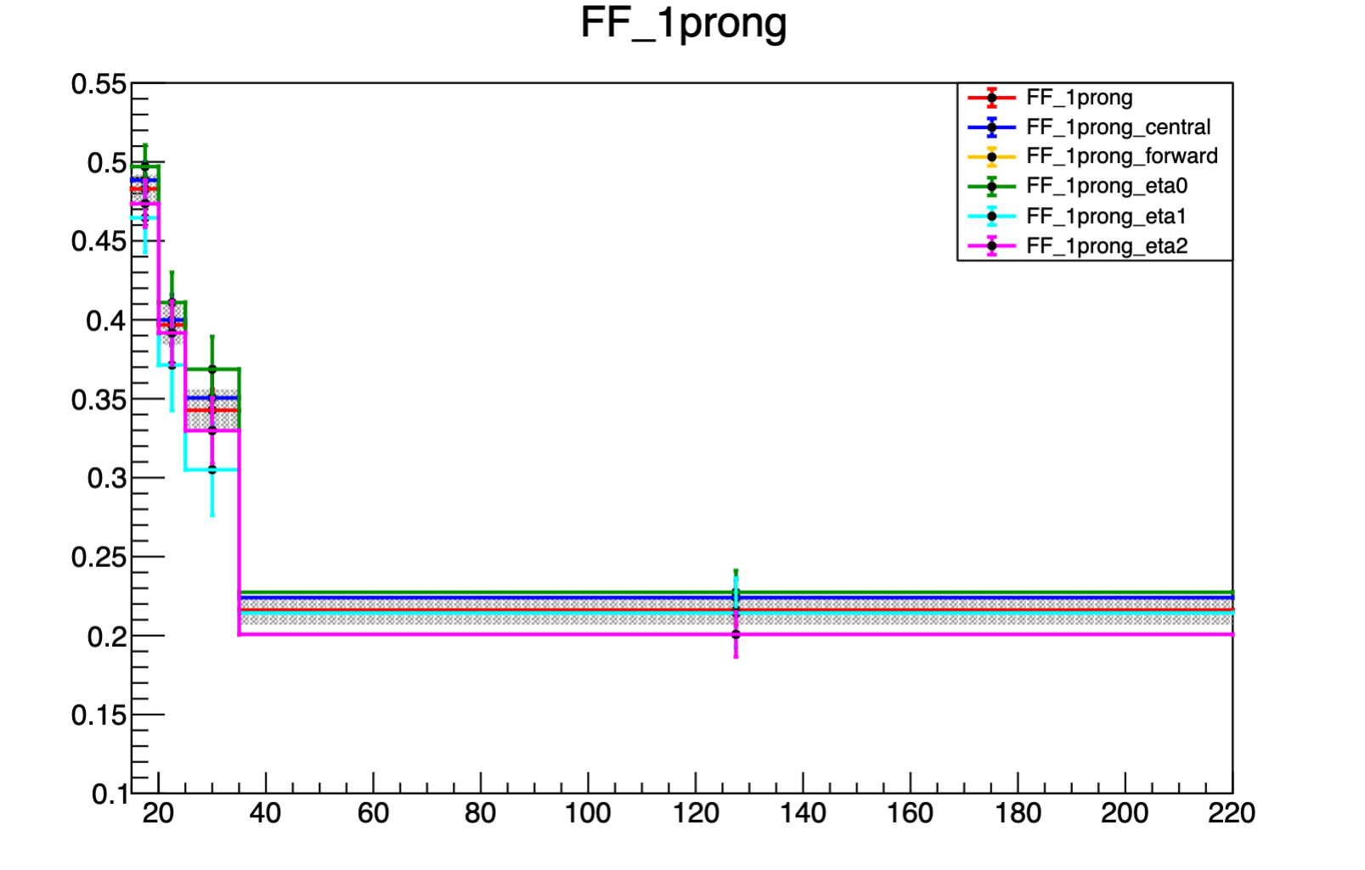
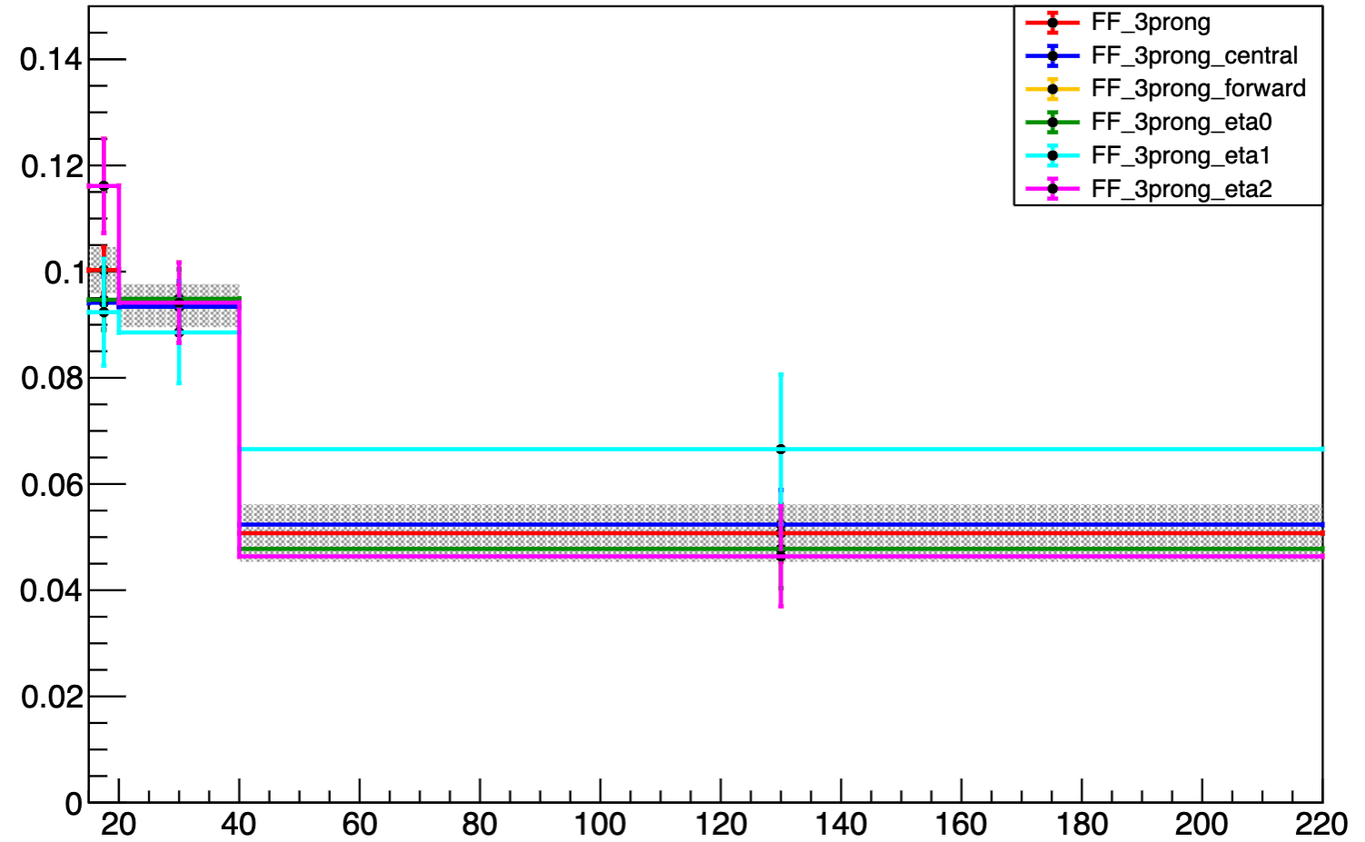
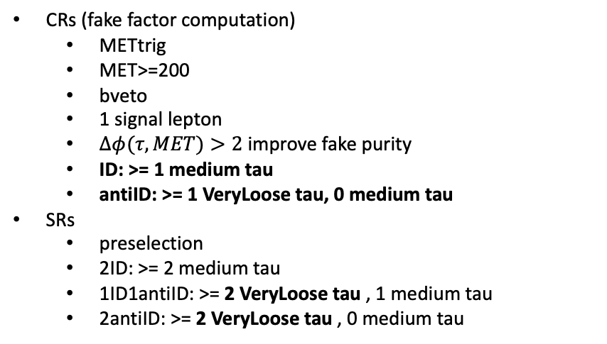
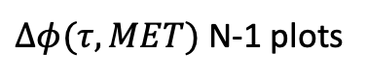
Direct Stau ISR fake estimation
CRs (fake factor computation)
METtrig
MET>=200
bveto
1 signal lepton
$Δφ(τ,MET)>2$ improve fake purity
ID: >= 1 medium tau
antiID: >= 1 VeryLoose tau, 0 medium tau
SRs
preselection
2ID: >= 2 medium tau
1ID1antiID: >= 2 VeryLoose tau , 1 medium tau
2antiID: >= 2 VeryLoose tau , 0 medium tau
FF determination
Data
FF application
Data
$Δφ(τ,MET)$ N-1 plots
CR
Pass ID
SR
Pass ID
SR
but
1 tau Fail ID
CR
Fail ID
SR
but
2 tau Fail ID
Binned in prongness, tau eta, tau pT
Eta bins
2 bins: central [0,1.37], forward [1.52,2.5]
3 bins: eta0,1,2 for [0,1), [1, 1.37], [1.52,2.5]
Auto binning:
> 10% of events in nominator and denominator
Add bins to bin i until it is not consistent anymore with bin i - 1
Relative stat uncertainty on ratio smaller than 50%
>10% events in nominator and denominator
9
Chengxin Liao
C1C1/C1N2 and Direct stau PAR

Slide 11
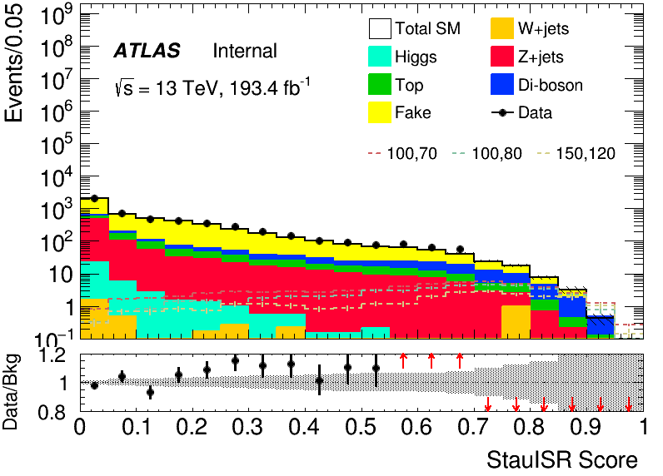
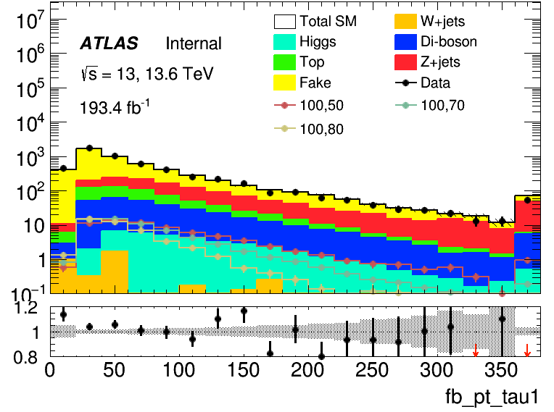
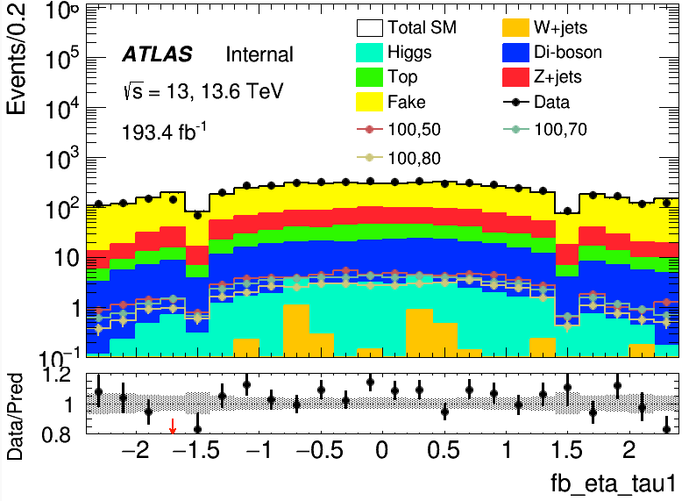
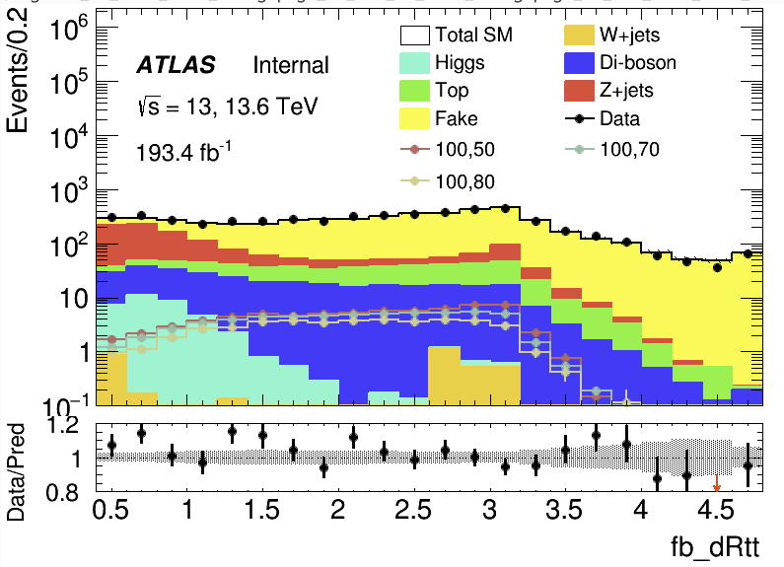
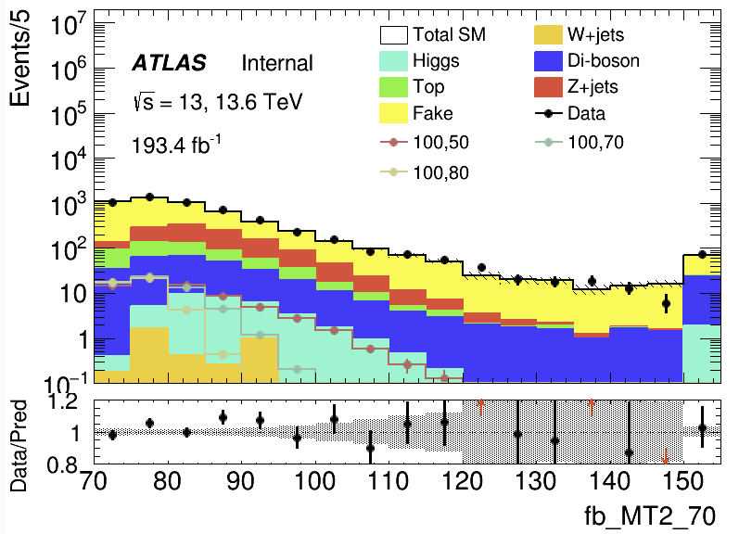

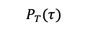
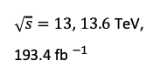
Direct Stau ISR fake estimation validation(HH)
Data-driven fakes in preselection region
Score distribution
Kinematic distribution
$\sqrt{s}=13$, $13.6$ TeV, 193.4 fb$^{−1}$
$$P_{T}(τ)$$
$$η(τ)$$
10
Chengxin Liao
C1C1/C1N2 and Direct stau PAR

Slide 12
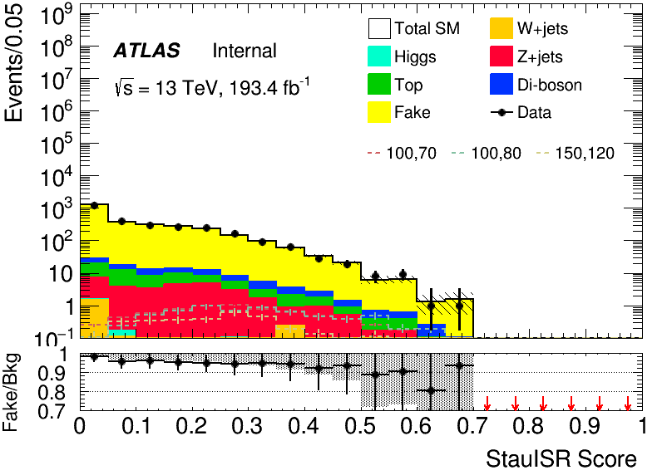
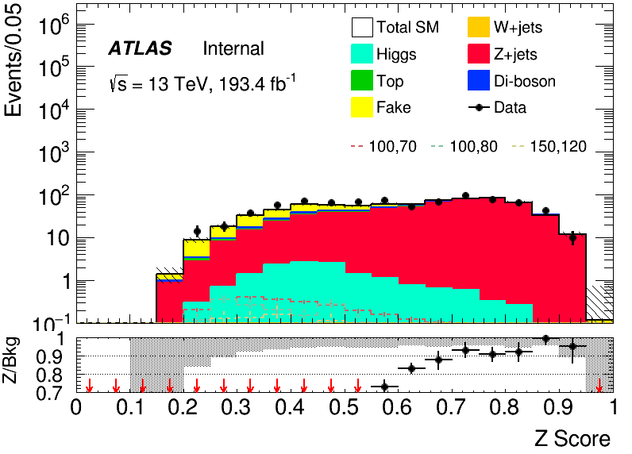
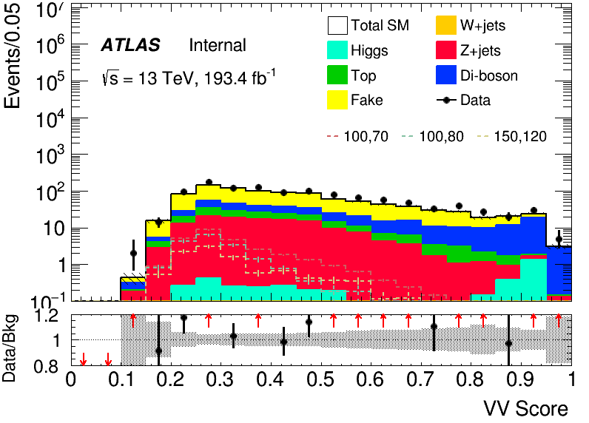
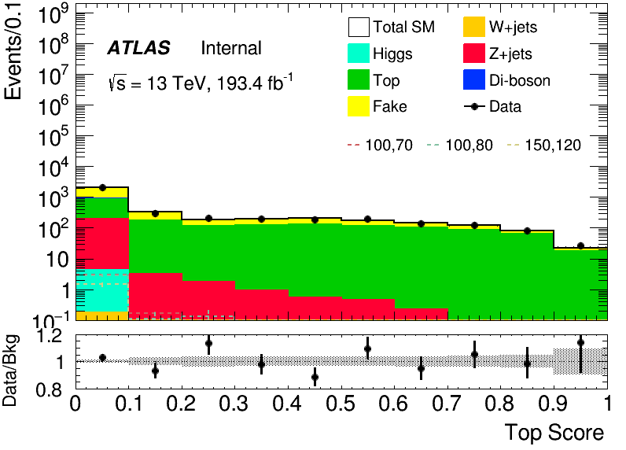
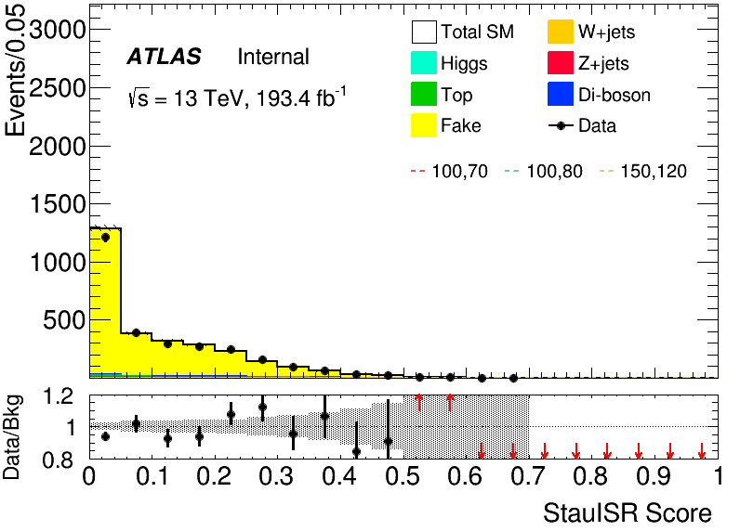
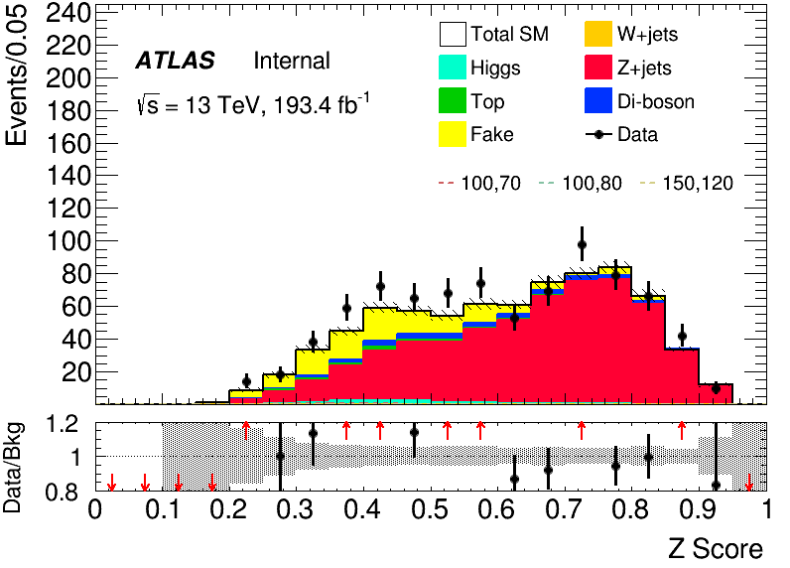
Direct Stau ISR background estimation (HH)
Region | Selections |  | Total Bkg | Dominant Bkg | Purity | Data | Data/Bkg
Fake VR | signal score < 0.7, max bkg score: Fake |  | 2870 +- 40 | 2770 +- 40 | 0.96 | 2794 | 0.972
Z CR | signal score < 0.7, max bkg score: Z | Z Score > 0.7 | 276 ± 7 | 257 ± 6 | 0.93 | 295 | 1.07
Z VR |  | Z Score ∈ (0.5, 0.7) | 251 ± 7 | 198 ± 5 | 0.79 | 264 | 1.05
VV VR | signal score < 0.7, max bkg score: VV | VV Score > 0.85 | 48 ± 2.8 | 30 ± 1.1 | 0.62 | 55 | 1.15
Top CR | HH bTag | Top Score > 0.6 | 374 +- 9 | 271 +- 5 | 0.72 | 375 | 1
Top VR |  | Top Score ∈ (0.5, 0.6) | 178 +- 6 | 178 +- 6 | 0.64 | 195 | 1.09
VR
VR
CR
VR
VR
CR
11
Chengxin Liao
C1C1/C1N2 and Direct stau PAR

Slide 13
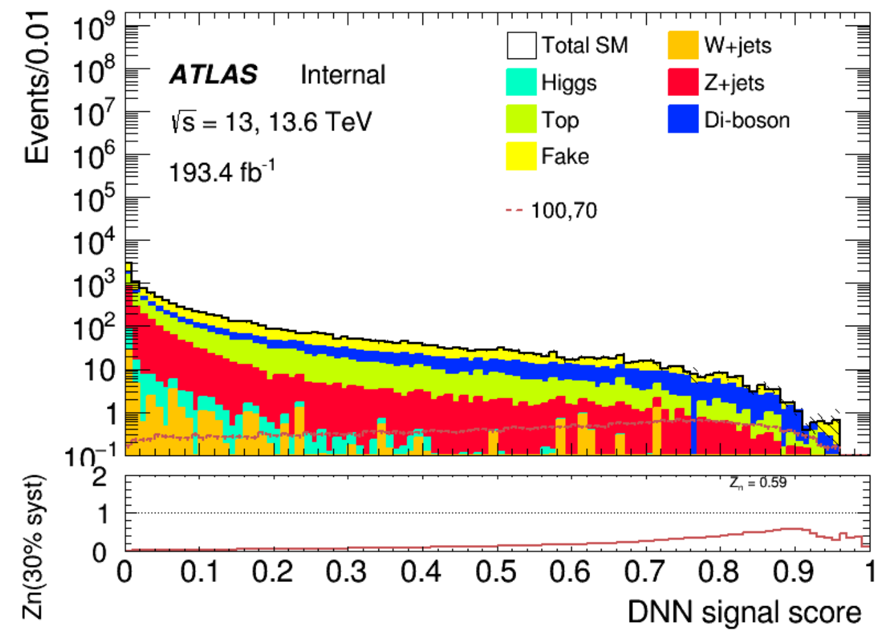
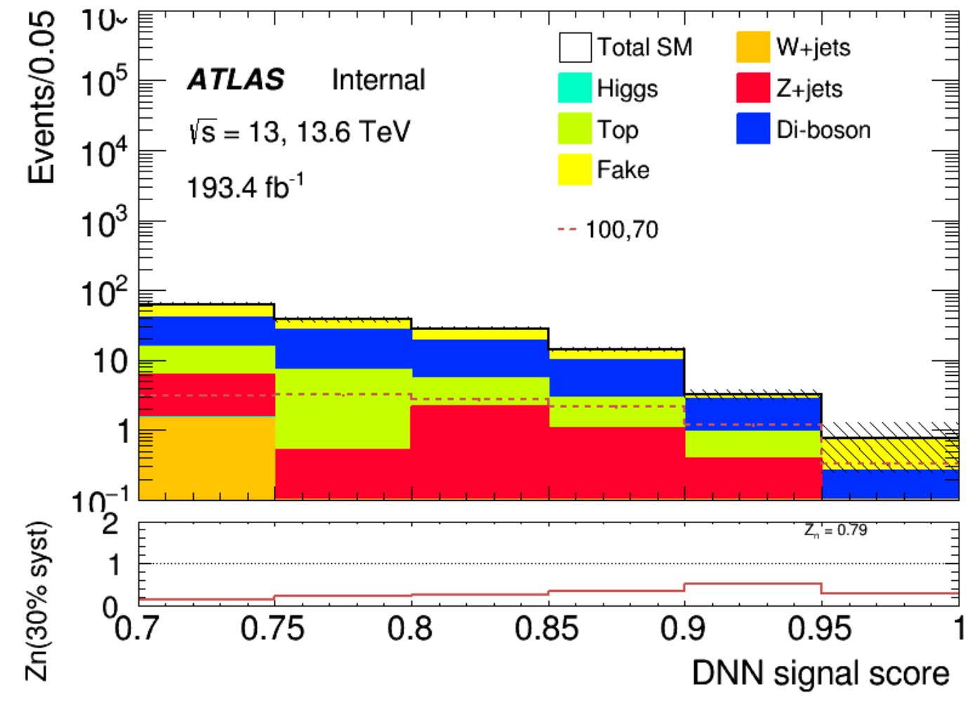
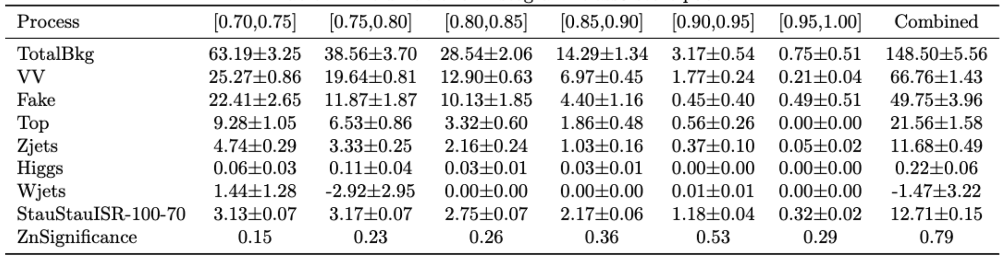
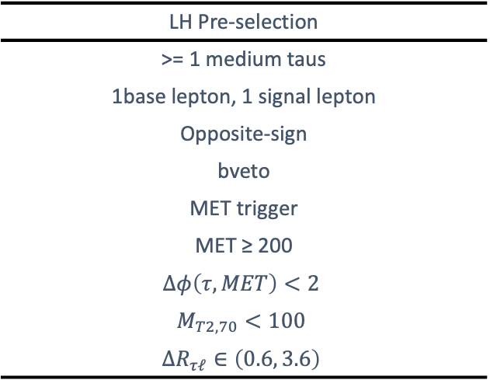
Direct Stau ISR signal region definition(LH)
Preselection
SR selection using neuron network score
Fake tau estimation using fake factor method
DNN signal score > 0.7
Background composition
LH Pre-selection
>= 1 medium taus
1base lepton, 1 signal lepton
Opposite-sign
bveto
MET trigger
MET ≥ 200
$$Δφ\left(τ,MET\right)<2$$
$$M_{T2,70}<100$$
$$ΔR_{τℓ}∈\left(0.6, 3.6\right)$$
SR
Pre-selection
DNN score > 0.7
12
Chengxin Liao
C1C1/C1N2 and Direct stau PAR

Slide 14
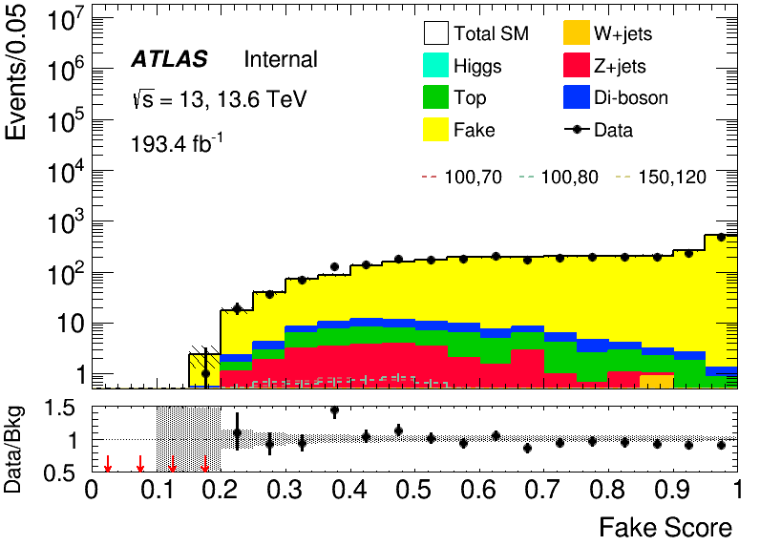
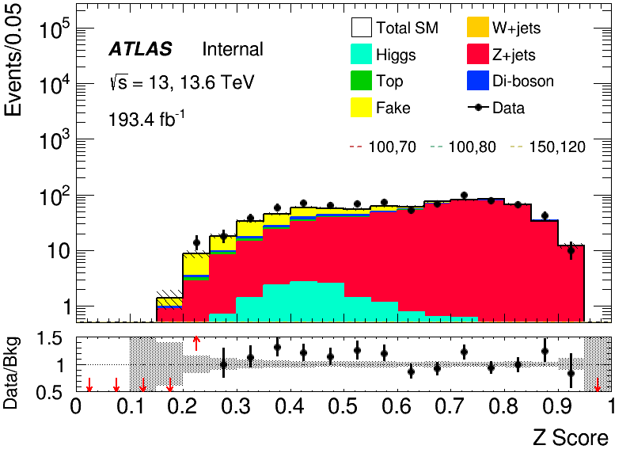
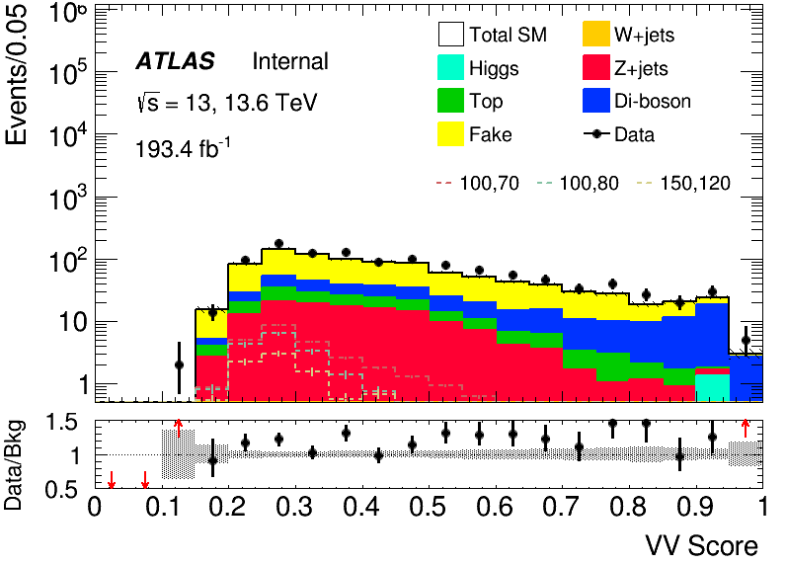
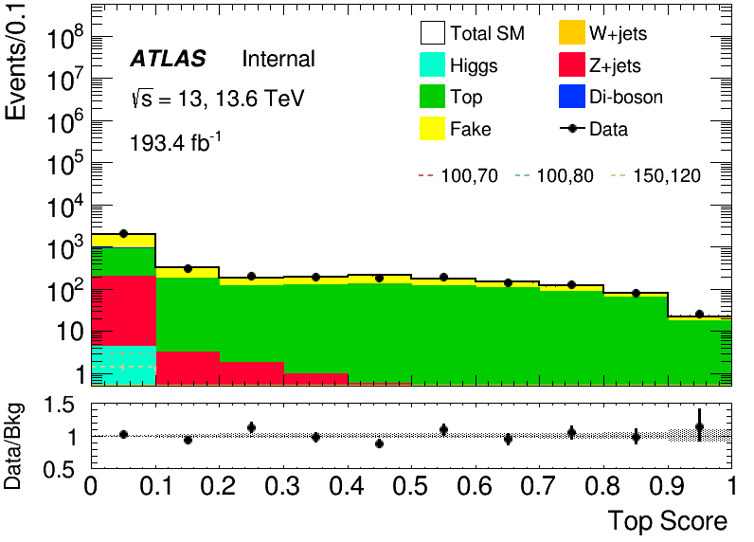
Direct Stau ISR background estimation (HH)
Region | Selections |  | Total Bkg | Dominant Bkg | Purity | Data | Data/Bkg
Fake VR | signal score < 0.7, max bkg score: Fake |  | 2870 +- 40 | 2770 +- 40 | 0.96 | 2794 | 0.972
Z CR | signal score < 0.7, max bkg score: Z | Z Score > 0.7 | 276 ± 7 | 257 ± 6 | 0.93 | 295 | 1.07
Z VR |  | Z Score ∈ (0.5, 0.7) | 251 ± 7 | 198 ± 5 | 0.79 | 264 | 1.05
VV VR | signal score < 0.7, max bkg score: VV | VV Score > 0.85 | 48 ± 2.8 | 30 ± 1.1 | 0.62 | 55 | 1.15
Top CR | HH bTag | Top Score > 0.6 | 374 +- 9 | 271 +- 5 | 0.72 | 375 | 1
Top VR |  | Top Score ∈ (0.5, 0.6) | 178 +- 6 | 178 +- 6 | 0.64 | 195 | 1.09
fake
Z+jets
VV
Top
VR
VR
CR
VR
VR
CR

Slide 15
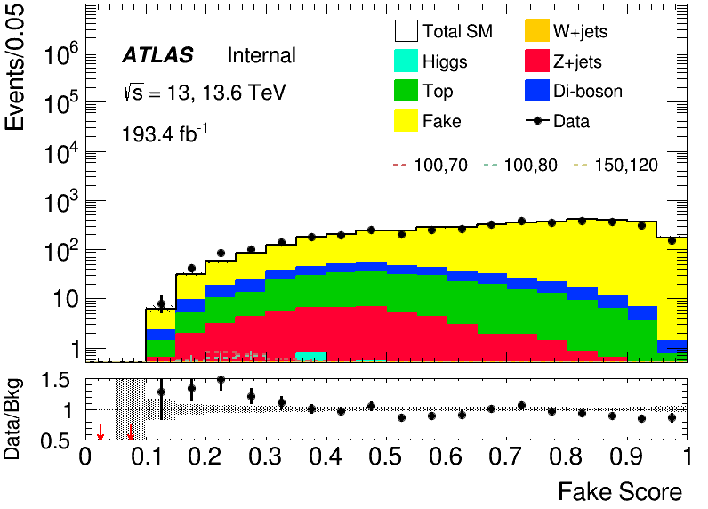
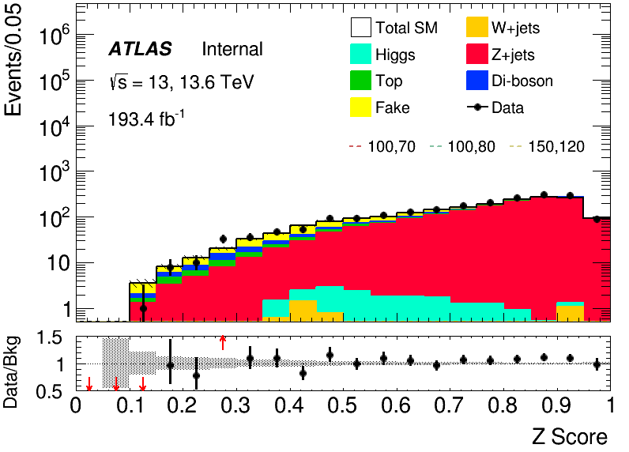


Direct Stau ISR background estimation (LH)
Region | Selections |  | Total Bkg | Dominant Bkg | Purity | Data | Data/Bkg
Fake VR | signal score < 0.7, max bkg score: Fake | Fake Score > 0.5 | 3190 ± 35 | 2950 ± 35 | 0.93 | 2977 | 0.9330
Z CR | signal score < 0.7, max bkg score: Z | Z Score > 0.7 | 1229 ± 9 | 1131 ± 6 | 0.92 | 1328 | 1.0808
Z VR |  | Z Score ∈ (0.6, 0.7) | 269 ± 6 | 195 ± 2.5 | 0.72 | 271 | 1.0075
VV CR | signal score < 0.7, max bkg score: VV | VV Score > 0.6 | 372 ± 6 | 264 ± 2.9 | 0.71 | 428 | 1.1521
VV VR |  | VV Score ∈ (0.5, 0.6) | 329 ± 6 | 172 ± 2.3 | 0.52 | 337 | 1.0246
Top CR | HH bTag | Top Score > 0.5 | 11110 ± 40 | 10510 ± 35 | 0.95 | 9936 | 0.8941
Top VR |  | Top Score ∈ (0.3, 0.5) | 4210 ± 27 | 3500 ± 20 | 0.83 | 3921 | 0.9303
VR
VR
CR
VR
CR
VR
CR

Slide 16

Direct Stau ISR signal region definition(LH)
Expected sensitvity
30% flat systematic uncertainty
13
Chengxin Liao
C1C1/C1N2 and Direct stau PAR

Slide 17

Direct Stau ISR Cut and Count(HH)
14
Chengxin Liao
C1C1/C1N2 and Direct stau PAR

Slide 18


Direct Stau ISR Cut and Count(HH)
SR(1-4)
Pre-selection
$80<M_{T}\left(τ_{1}, MET\right)<140$, $60<M_{T}(τ_{2},MET)$ < 100 (SR1)
$80<M_{T}\left(τ_{1}, MET\right)<140$, $100<M_{T}(τ_{2},MET)$ (SR2)
$140<M_{T}\left(τ_{1}, MET\right)$, $60<M_{T}(τ_{2},MET)$ < 100 (SR3)
$140<M_{T}\left(τ_{1}, MET\right)$, $100<M_{T}(τ_{2},MET)$ (SR4)
Sensitivity for any pair production of ${\tilde{τ}}_{l}$ + ${\tilde{τ}}_{R}$ pair-production with 30% flat systematic uncertainty
 | SR1 | SR2 | SR3 | SR4 | All
VV | 2.88 | 2.49 | 2.58 | 1.05 | 9
Top | 2.05 | 1.16 | 0.20 | 0.32 | 3.73
Wjets | 0.32 | 0.40 | 0.48 | 0.0 | 1.2
Zjets | 1.06 | 0.79 | 0.57 | 0.32 | 2.74
BG Sum | 6.31 | 4.84 | 3.83 | 1.69 | 16.67
Signal (100, 70) | 2.35 | 2.15 | 2.00 | 1.73 | 8.23
Significance | 0.69 | 0.75 | 0.80 | 1.14 | 1.73
15
Chengxin Liao
C1C1/C1N2 and Direct stau PAR

Slide 19

Direct Stau ISR Cut and Count(LH)
16
Chengxin Liao
C1C1/C1N2 and Direct stau PAR

Slide 20

Direct Stau ISR Cut and Count(LH)
SR(1-4)
Pre-selection
nJets = 1, 25<= tau pt <= 50(SR1)
nJets > 1, 25 <= tau pt <= 50(SR2)
nJets = 1, tau pt > 50(SR3)
nJets > 1, tau pt > 50(SR4)
Sensitivity mapping with 30% systematic uncertainty
17
Chengxin Liao
C1C1/C1N2 and Direct stau PAR

Slide 21

Direct Stau ISR Background Estimation
18
Chengxin Liao
C1C1/C1N2 and Direct stau PAR

Slide 22

Direct Stau ISR Background Estimation
19
Chengxin Liao
C1C1/C1N2 and Direct stau PAR

Slide 23


Direct Stau single-lep trigger motivation
Sensitivity to direct stau production is difficult
Low cross-sections
Hadronically-decaying taus are difficult objects
Possible final states … and problems
τ_{had} τ_{had} BR = 42% trigger on 2x high pT taus, large Δm
τ_{had} τ_{lep} BR = 46% large W+jets background
τ_{lep} τ_{lep} BR = 12% leptons are soft (Ben H study)
τ_{had} τ_{had} has been the main focus for ATLAS so far, with potential improvements at low mass from Dom’s ML efforts.
2-tau triggering 95,75 or 75,40+MET 150 kills moderate Δm signals.
Huge uncovered region from moderate Δm → low Δm.
Target with the τ_{had} τ_{lep} channel and use single lep triggers
before: 71267.95
after: 24429.68
20
Chengxin Liao
C1C1/C1N2 and Direct stau PAR

Slide 24





Direct Stau signle-lep trigger SR definition(LH)
LH Pre-selection
== 1 Tight taus (OS)
1 signal lepton
bveto
Single-lepton trigger
15 GeV < MET < 200 GeV METSig > 2 MT2 < 90 $$dR\left(lep,tau\right)<3.6$$ custom MT cut*
$φ_{\{1,2\}} cut$*
>=1J channel
Main bkg: fake, Z+jets
=0J channel
CR
VR
SR
SR
CR?
VR?
SR
Pre-selection
>=1 Jet | == 0 Jet
DNN score > 0.9
>=1J channel
Z = 1.01
0J channel
Z = 0.36
21
Chengxin Liao
C1C1/C1N2 and Direct stau PAR

Slide 25
Direct Stau single-lep trigger background estimation(LH)
>= 1J channel
Region | Selections |  | channel | Total Bkg |  | Dominant Bkg |  | Purity
Fake CR | 0.5 < signal score < 0.7, max bkg score: Fake | fake score > 0.3 | e-channel | 5557 | 10628 | 4746 | 9029 | 0.85 | 0.85
 |  |  | muon-channel | 4283 |  | 4283 |  | 0.84
Top CR | 0.5 < signal score < 0.7, max bkg score: Top | Top score > 0.27 | e-channel | 256 | 555 | 203 | 449 | 0.79 | 0.82
 |  |  | muon-channel | 299 |  | 245 |  | 0.82
Z CR | 0.5 < signal score < 0.7, max bkg score: Z | Z score > 0.28 | e-channel | 457 | 775 | 374 | 631 | 0.82 | 0.82
 |  |  | muon-channel | 317 |  | 256 |  | 0.81
VV CR | 0.0 < signal score < 0.7, max bkg score: VV | VV Score > 0 | e-channel | 145 | 264 | 72 | 134 | 0.50 | 0.50
 |  |  | muon-channel | 118 |  | 61 |  | 0.52
Fake VR | 0.7 < signal score < 0.9, max bkg score: Fake | fake score > 0.2 | -- | 2601 |  | 2166 |  | 0.83
Top VR | 0.7 < signal score < 0.9, max bkg score: Top | Top score > 0.2 | -- | 128 |  | 95 |  | 0.74
Z VR | 0.7 < signal score < 0.9, max bkg score: Z | Z score > 0.165 | -- | 247 |  | 189 |  | 0.76
VV VR | 0.7 < signal score < 0.9, max bkg score: VV | VV score > 0.06 | -- | 166 |  | 84 |  | 0.51
*(Note: MC fakes are only place holders, will be replaced with data driven background in final fit and CR will be added to VR)
22
Chengxin Liao
C1C1/C1N2 and Direct stau PAR

Slide 26








Direct Stau single-lep trigger background estimation (LH)
CR-fakes
VR-fakes
e channel
muon channel
CR-fakes
CR-fakes
VR-top
e channel
muon channel
CR-top
CR-top
CR-top
*(Note: MC fakes are only place holders, will be replaced with data driven background in final fit and CR will be added to VR)
23
Chengxin Liao
C1C1/C1N2 and Direct stau PAR
DNN score numbers:
0: signal
1: fakes
2: top
3: Ztt
4: diboson
5: other

Slide 27








Direct Stau single-lep trigger background estimation(LH)
Z CR
Z VR
e-channel
muon-channel
Z CR
Z CR
e-channel
muon-channel
VV CR
VV VR
VV CR
VV CR
*(Note: MC fakes are only place holders, will be replaced with data driven background in final fit and CR will be added to VR)
24
Chengxin Liao
C1C1/C1N2 and Direct stau PAR

Slide 28




Direct Stau single-lep trigger background estimation(LH)
= 0J channel
Region | Selections |  | Total Bkg | Dominant Bkg | Purity
Fake CR | 0.5 < signal score < 0.7, max bkg score: Fake | fake score > 0.3 | 18046 | 16348 | 0.91
Z CR | 0.2 < signal score < 0.5, max bkg score: Z | Z score > 0.48 | 345 | 305 | 0.88
Fake VR | 0.7 < signal score < 0.9, max bkg score: Fake | fake score > 0.1 | 17214 | 14782 | 0.85
Z VR | 0.5 < signal score < 0.9, max bkg score: Z | Z score > 0.1 | 766 | 338 | 0.44
CR-fakes-0J
VR-fakes-0J
CR-Ztt-0J
VR-Ztt-0J
fakes: 16348.64
Total: 18046.57
specific bg purity: 91%
fakes: 14782.23
Total: 17214.01
specific bg purity: 85%
Ztt: 338.22
Total: 766.27
specific bg purity: 44%
Ztt: 305.77
Total: 345.52
specific bg purity: 88%
*(Note: MC fakes are only place holders, will be replaced with data driven background in final fit and CR will be added to VR)
25
Chengxin Liao
C1C1/C1N2 and Direct stau PAR

Slide 29




Direct Stau single-lep trigger background only fit (LH)
>= 1 J channel(combined)
>= 1J channel e/mu separate
VR
VR
VV
Z+jets
fake
top
VV
Z+jets
fake
top
26
Chengxin Liao
C1C1/C1N2 and Direct stau PAR

Slide 30


Direct Stau single-lep trigger background only fit (LH)
= 0 J channel
27
Chengxin Liao
C1C1/C1N2 and Direct stau PAR

Slide 31

Direct Stau single-lep trigger background only fit (LH)
Type of systematic | % Syst. | [ | Expected CLs | ]
Normalisation | 1 | 0.238 | 0.437 | 0.699
Normalisation | 10 | 0.238 | 0.437 | 0.699
Normalisation | 20 | 0.238 | 0.437 | 0.699
Normalisation | 50 | 0.240 | 0.439 | 0.701
Norm+Shape | 1 | 0.238 | 0.437 | 0.699
Norm+Shape | 20 | 0.238 | 0.437 | 0.699
Norm+Shape | 50 | 0.240 | 0.439 | 0.701
Experimented running exclusion fit with Asimov data using different systematics (both FlatSys and ShapeSys).
Overall, expected CLs very robust to size of systematics, limited by signal statistics
Sensitivity worse than estimated from simple Z score formula
(Mu factors preliminary since dominant fake background MC will be replaced)*
28
Chengxin Liao
C1C1/C1N2 and Direct stau PAR

Slide 32

Direct Stau single-lep trigger Exclusion Fit(LH)
0J and >= 1J channel combined
Including the 0J and >=1J channel together in the exclusion fit, we get a slight decrease in the expected CLs, but not much
Not that surprising, DNN studies showed >=1J channel drives sensitivity
ShapeSys further away from zero (~0.58)
Type of systematic | % Syst. | [ | Expected CLs | ]
Normalisation | 20 | 0.231 | 0.429 | 0.693
Norm+Shape | 20 | 0.231 | 0.429 | 0.693
29
Chengxin Liao
C1C1/C1N2 and Direct stau PAR

Slide 33

Direct Stau single-lep trigger OS-SS Fit(LH)
Idea to use same-sign (SS) region in the fit to constrain systematics
Can model any differences between the extrapolation
Applied this as a simultaneous fit of the OS and SS data with a floating common component
Ran test with much simpler SR with fewer (16) bins in >=1J channel
Systematics significantly more constrained, but as seen before, we are not systematics limited, so small impact on resulting CLs value
Small signal statistics remains main issue
Type of fit | % Syst. | [ | Expected CLs | ]
OS only | 20 | 0.242 | 0.442 | 0.703
OS-SS | 20 | 0.242 | 0.441 | 0.702
30
Chengxin Liao
C1C1/C1N2 and Direct stau PAR

Slide 34




Direct Stau fake estimation(LH)
CRs (fake factor computation)
Single lepton trigger
OS/SS
1 signal lepton
ID: >= 1 tight tau
antiID: > 0.05 RNN score, no tight tau
SRs
Single lepton trigger
MET > 15GeV
B-veto
OS/SS
ID: >= 1 tight tau
antiID: > 0.05 RNN score, no tight tau
Focus on W+jets and ttbar
MC fakes
Data Driven
Better aggrement for high pt
Binned in prongness, tau pT
FF determination
Data
FF application
Data
MC fakes
Data Driven
CR
Pass ID
SR
Pass ID
Still worse aggrement for high pt
Under investigated
CR
Fail ID
SR
Fail ID
31
Chengxin Liao
C1C1/C1N2 and Direct stau PAR

Slide 35




Direct Stau fake estimation(LH)
Focus on events with taus with pT 20-25 GeV
Top: OS
Bottom: SS
Better agreement with data-driven fake taus compared to MC for different numbers of jets in the event
32
Chengxin Liao
C1C1/C1N2 and Direct stau PAR

Slide 36


C1C1/C1N2 Motivation
C1C1, C1N2 via stau with $≥2τ+E_{T}^{miss}+ISR$
Boosted by ISR and has a large MET due to two miss ${\tilde{χ}}_{1}^{0}$
33
Chengxin Liao
C1C1/C1N2 and direct stau PAR

Slide 37


C1C1 ISR signal region optimization
BDT method for signal region optimization
30% flat systemic uncertainty
Figure of merit: Zn
5fold to Train(Cross-Validation)
Preselection based on final state($τ$ $τ$ or$τ l$)
HH Pre-selection
>= 2 medium taus
0 base lepton
MET ≥ 150; pass MET trigger
1≤nJet
Opposite-sign hadronic-hadronic tau pair
bveto
jet pt>100 GeV
LH Pre-selection
>= 1 medium taus
1 base lepton, 1 signal lepton
MET ≥ 200; pass MET trigger
1≤nJet
Opposite-sign lepton-hadronic tau pair
bveto
jet pt>100 GeV
34
Chengxin Liao
C1C1/C1N2 and direct stau PAR

Slide 38



C1C1 ISR signal region definition(HH)
SR
Pre-selection
BDT score > 0.9
Binned significance: 3.32
Sensitive map
35
Chengxin Liao
C1C1/C1N2 and direct stau PAR

Slide 39

C1C1 ISR signal region definition(LH)
SR
Pre-selection
BDT score > 0.9
Binned significance: 5.36
Sensitive map
36
Chengxin Liao
C1C1/C1N2 and direct stau PAR

Slide 40


C1C1 ISR Z+jets estimation(LH)
selections highlighted in green make SR and CR/VR orthogonal
 | selection | purity | Total Bkg | Dominant Bkg | Data | Data/Bkg
ZCR | Pre-selection 40 GeV<M_{ττ}^{reco} <100 GeV BDT score<-0.8 | 0.79 | 1615+-16 | 1272+-15 | 1611 | 0.99
ZVR | Pre-selection 40 GeV<M_{ττ}^{reco} <100 GeV -0.8<BDT score<0.9 | 0.76 | 623+-12 | 472+-10 | 619 | 0.99
Distributions after pre-selection and 40 GeV<M_{ττ}^{reco} <100 GeV
37
Chengxin Liao
C1C1/C1N2 and direct stau PAR

Slide 41


C1C1 ISR Top estimation(LH)
selections highlighted in green make SR and CR/VR orthogonal
 | selection | purity | Total Bkg | Dominant Bkg | Data | Data/Bkg
topCR | Pre-selection without bVeto Number of B jets > 0 M(lep,met) > 200 GeV | 0.96 | 8367+-34 | 8043+-34 | 7404 | 0.89
topVR | Pre-selection without bVeto Number of B jets > 0 120 GeV < M_{int}(lep,met) < 200 GeV | 0.94 | 5674+-35 | 5345+-34 | 5141 | 0.90
Distributions after pre-selection with bTag
38
Chengxin Liao
C1C1/C1N2 and direct stau PAR

Slide 42





C1N2 ISR signal region optimization
BDT method for signal region optimization
30% flat systemic uncertainty
Figure of merit: Zn
5fold to Train(Cross-Validation)
Preselection based on final state($τ$ $τ$ or$τ l$)
HH Pre-selection
>= 2 medium taus
0 base lepton
MET ≥ 200; pass MET trigger
1≤nJet
Opposite-sign hadronic-hadronic tau pair
bveto
jet pt>100 GeV
$$M_{ττ}^{reco}<40 GeV or M_{ττ}^{reco}>130 GeV$$
LH Pre-selection
>= 1 medium taus
>=1 base lepton, >=1 signal lepton
MET ≥ 200; pass MET trigger
1≤nJet
Opposite-sign lepton-hadronic tau pair
bveto
jet pt>100 GeV
$$M_{ττ}^{reco}<40 GeV or M_{ττ}^{reco}>130 GeV$$
Grid Search for the best model
Penalty function to balance the AUC and overfit
39
Chengxin Liao
C1C1/C1N2 and direct stau PAR

Slide 43





C1N2 ISR signal region definition(HH)
SR definition using BDT score(HH)
Fake tau estimation using fake factor method
Three bins [0.80, 0.86], [0.86, 0.90], [0.90, 1.00]
Fake estimation is same with direct stau only change signal lep to at least signal lep
HH Pre-selection
>= 2 medium taus
0 base lepton
MET ≥ 150; pass MET trigger
1≤nJet
Opposite-sign hadronic-hadronic tau pair
bveto
jet pt>100 GeV
$$M_{ττ}^{reco}<40 GeV or M_{ττ}^{reco}>130 GeV$$
SR
Pre-selection
BDT score > 0.8
40
Chengxin Liao
C1C1/C1N2 and direct stau PAR

Slide 44





C1N2 ISR background estimation(HH)
Selection for control region and validation region
VR
VR
CR
VR
CR
VR
VR
41
Chengxin Liao
C1C1/C1N2 and direct stau PAR

Slide 45




C1N2 ISR signal region definition(LH)
SR definition using BDT score(LH)
Fake tau estimation using fake factor method
BDT score > 0.9
Three bins [0.91, 0.94], [0.94, 0.96], [0.96, 1.00]
LH Pre-selection
>= 1 medium taus
>=1 base lepton, >=1 signal lepton
MET ≥ 200; pass MET trigger
1≤nJet
Opposite-sign lepton-hadronic tau pair
bveto
jet pt>100 GeV
$$M_{ττ}^{reco}<40 GeV or M_{ττ}^{reco}>130 GeV$$
SR
Pre-selection
BDT score > 0.91
42
Chengxin Liao
C1C1/C1N2 and direct stau PAR

Slide 46






C1N2 ISR background estimation(LH)
Selection for control region and validation region
VR
CR
VR
VR
VR
CR
43
Chengxin Liao
C1C1/C1N2 and direct stau PAR

Slide 47
Backup

Slide 48




Direct Stau ISR Fake purity in CR
1-prong
3-prong
ID
anti-ID

Slide 49
Direct Stau ISR Fake Factor
Binned in prongness, tau eta, tau pT
Eta bins
2 bins: central [0,1.37], forward [1.52,2.5]
3 bins: eta0,1,2 for [0,1), [1, 1.37], [1.52,2.5]
Auto binning:
> 10% of events in nominator and denominator
Add bins to bin i until it is not consistent anymore with bin i - 1
Relative stat uncertainty on ratio smaller than 50%
>10% events in nominator and denominator
1-prong: 3 eta bins
3-prong: central, forward regions

Slide 50






Direct Stau ISR Neuron network(HH)
Model Architecture
Neurons: [256, 128, 128, 64, 32]
Activation Function: Leaky ReLU
Batch Normalization
Dropout Rate: 0.3
L2 Regularization (λ): 1e-4
Training Configuration
Optimizer: Adam
Learning Rate: 1e-3
Batch Size: 128
Epochs: 600
Reduce Learning Rate on Plateau:
Monitor: val_loss
Factor: 0.5
Patience: 20
Class weight to solve imbalance issue
Normalization before training
$\frac{X−μ}{σ}$
Drop Negative weight

Slide 51








Direct Stau ISR Neuron network(LH)
AUC for 6 output scores
ISR
Fake
VV
Top
Zjets
Others
(W+jets,Higgs)

Slide 52

Direct Stau ISR Class Weight
$w_{i}=I_{i}⋅\frac{N_{all}}{n_{class}×N_{i}}$
$N_{all}$​: The total sum of weight in the entire dataset (across all classes).
$N_{i}$: The sum of weight belonging to class i.
$n_{class}$: The total number of distinct classes in the dataset.
$I_{i}$: importance factor

Slide 53

Direct Stau ISR Top, Ztt CR

Slide 54

Direct Stau ISR Diboson CR

Slide 55

Direct Stau ISR VRs

Slide 56






Direct Stau MC modeling check
Requirements: 1e/mu passing trigger, at least 1 tight signal tau
MC overestimates data
2015+16
2017
2018
2015+16
2017
2018

Slide 57






Direct Stau MC modeling check
Requirements: 1e/mu passing trigger, at least 1 tight signal tau
MC overestimates data
2022
2023
2024
2022
2023
2024

Slide 58







Direct Stau Pre-selection(LH)
*custom MT cut (removes red shape):
Targets Ztt
(mT_sum > 70_000) &
((mT_lep_met > 20_000) | (mT_tau_met > 90_000)) &
((mT_lep_met > 90_000) | (mT_tau_met > 20_000))
*phi_{1,2} cut (removes red circle slice):
Targets fakes
Define:
Cut:
(abs(phi1)-a)**2 + (abs(phi2)-b)**2 >= r**2
where a=pi, b=pi, and r = pi/2
Zττ+jets
LH Pre-selection
== 1 Tight taus (OS)
1 signal lepton
bveto
Single-lepton trigger
15 GeV < MET < 200 GeV METSig > 2 MT2 < 90 $$dR\left(lep,tau\right)<3.6$$ custom MT cut*
$φ_{\{1,2\}} cut$*
before: 275.78
after: 263.50
before: 71267.95
after: 24429.68
W+jets
before: 263.50
after: 257.31
before: 207701.89
after: 145037.45
7
Chengxin Liao
C1C1/C1N2 and Direct stau PAR

Slide 59


Direct Stau DNN Training
Train deep neural network (DNN) to separate signal from background and cut on network score targeting (100, 50) & (150,100) mass points (high stats points with 1M events generated) and trained 0J and >=1J channels separately.
Training converges well (across all training folds) and very good signal/background separation is achieved
Use multiclass DNN with 6 output classes: Signal, fake-tau background, 4 real-backgrounds (top, Ztt, VV, other)
Input variables:
Basic object variables: p_{T}, η, MET, charge etc.
High-level variables: ΔR, Δη, Δφ, m_{T2}, M_{eff}, M_{inv}, Σm_{T}, m_{CT}, balance + more!
Training loss
Validation loss

Slide 60




Direct Stau Fake Factors

Slide 61




Direct Stau Fake Factors

Slide 62
C1C1 ISR signal region optimization(HH)
Input:
data: MC events passing pre-selection
signal: 39382 events C1C1 + ISR, M(C1, N1) = (100, 70) GeV
Bkg: 1089081 events.
feature:Pzetaj1,Pzetae,MCTtt,m_jet,dPhiISRV,dPhiVI,nS_tau,PtV,dPhit2x,maxdPhit1j,maxdPhit2j,METOPttau2,METOHTtt,METOHTjet,Ptjet1OPttau1,MT2tt_110,mtx_jet,mtx_lep,mt_lep,mt_C1C1,MTtau2met,MTtaumin,MTsum,Mtsum,Mtsumj,Mll,MT2,MET,METsig
Strategy
TMVA.Types.kBDT
Cross-Validation(5-fold)
hyper paramter: NTrees=400,learning rate=0.1,max depth=8, MinNodeSize=1%
other set-up: nCuts=20:BoostType=Grad:UseBaggedBoost=true:BaggedSampleFraction=0.5:NegWeightTreatment=Pray
20
Chengxin Liao
C1C1/C1N2 and direct stau PAR

Slide 63
C1C1 ISR signal region optimization(LH)
Input:
data: MC events passing pre-selection
signal: ISRC1C1(with C1 mass=100GeV, N1 mass=70 GeV)(39336 events)
bkg(1559557 events).
feature: dRt1x,dRtt,dPhitt,e_lep,mt_lep,ht_tau,METsig,nBaseJet,mindPhije,maxdPhit2j,MTtau1met,MTtau2met,MTtaumin,
MTtot,MTsum,Minvtt,Minvt2j,MT2tt_110,MCTtt,Pzetaj1,Pzetatt,METOPttau1,METOPttau2,METOHTtt,METOHTjet,Ptjet1OPttau1,Ptjet1OPttau2,Ptjet1OHTtt,PtV
Strategy
TMVA.Types.kBDT
5-fold train
hyper paramter: NTrees=300,learning rate=0.05,max depth=6, MinNodeSize=1%
other set-up: nCuts=20:BoostType=Grad:UseBaggedBoost=true:BaggedSampleFraction=0.5:NegWeightTreatment=Pray
22
Chengxin Liao
C1C1/C1N2 and direct stau PAR

Slide 64

C1N2 ISR Binary class(HH)
Hyperparameters: Ntrees = 200, MaxDepth = 6, MinNodeSize = 2%, Learning rate = 0.03(initial setting)
Feature engineering: Select a simple model and put all features into model, choose Top 30 vars based on importance list, drop high correlated vars Final feature list:
Weight choose: no weight, abs(weight)
No weight have better performance but abs(weight) fit our anaysis requirment
Split strategy: Separate entries by using mod 5, for Fake bkg, if separate follow sequence, all weighted entry will split into first fold
22
Chengxin Liao
C1C1/C1N2 and Direct stau PAR

Slide 65
C1N2 ISR Binary class(HH)
Class: C1N2, bkg
Hyperparameter tune: use optuna to auto-optimze
Test_auc = \sum{Test_auc_class} Train_auc = \sum{Train_auc_class}
constraint: average of AUC need to >= 0.6 penalty function: score = test_auc – 0.3*auc_gap (auc_gap = abs(train_auc- test_auc)) maximum(score)
Grid Search Ntrees: [200, 300, 400]
MaxDepth: [4, 6, 8, 10] MinNode: [1, 3, 5, 7]
Learning rate: [0.001, 0.005, 0.01, 0.05, 0.1]
Best one: Ntree=300, MaxDepth=6, MinNode=1%, Learning Rate=0.05
There still have rooms to optimize for lr
22
Chengxin Liao
C1C1/C1N2 and Direct stau PAR

Slide 66





C1N2 ISR Binary class(HH)
Overfit Check
22
Chengxin Liao
C1C1/C1N2 and Direct stau PAR

Slide 67





C1N2 ISR Binary class(HH)
50 bins
Cut at 0.8
rebin
Sum Zn = 7.65
22
Chengxin Liao
C1C1/C1N2 and Direct stau PAR

Slide 68

C1N2 ISR Binary class(LH)
Hyperparameters: Ntrees = 200, MaxDepth = 6, MinNodeSize = 2%, Learning rate = 0.03(initial setting)
Feature engineering: Select a simple model and put all features into model, choose Top 30 vars based on importance list, drop high correlated vars Final feature list:
Weight choose: no weight, abs(weight)
No weight have better performance but abs(weight) fit our anaysis requirment
Split strategy: Separate entries by using mod 5, for Fake bkg, if separate follow sequence, all weighted entry will split into first fold
22
Chengxin Liao
C1C1/C1N2 and Direct stau PAR

Slide 69





C1N2 ISR Binary class(LH)
Overfit Check
22
Chengxin Liao
C1C1/C1N2 and Direct stau PAR

Slide 70




C1N2 ISR Binary class(LH)
100 bins
Cut at 0.91
rebin
Narrow peak
Sum Zn = 4.934
22
Chengxin Liao
C1C1/C1N2 and Direct stau PAR

Slide 71



C1N2 ISR fake estimation(HH)
CRs (fake factor computation)
METtrig
MET>=200
bveto
at least 1 signal lepton
$Δφ(τ,MET)>2$
ID: >= 1 medium tau
antiID: >= 1 VeryLoose tau, 0 medium tau
SRs
preselection
2ID: >= 2 medium tau
1ID1antiID: >= 2 VeryLoose tau , 1 medium tau
2antiID: >= 2 VeryLoose tau , 0 medium tau
FF determination
Data
FF determination
Data
CR
Pass ID
SR
Pass ID
SR
but
1 tau Fail ID
CR
Fail ID
SR
but
2 tau Fail ID
Binned in prongness, tau eta, tau pT
Eta bins
2 bins: central [0,1.37], forward [1.52,2.5]
3 bins: eta0,1,2 for [0,1), [1, 1.37], [1.52,2.5]
Auto binning:
> 10% of events in nominator and denominator
Add bins to bin i until it is not consistent anymore with bin i - 1
Relative stat uncertainty on ratio smaller than 50%
>10% events in nominator and denominator
22
Chengxin Liao
C1C1/C1N2 and Direct stau PAR

